Slide 1
Investigating Variation in Forest Characteristics as Determinants of Land Use Histories
MAYA SOLLY AND GUILLEM GONZÁLEZ PACIOS

Slide 2
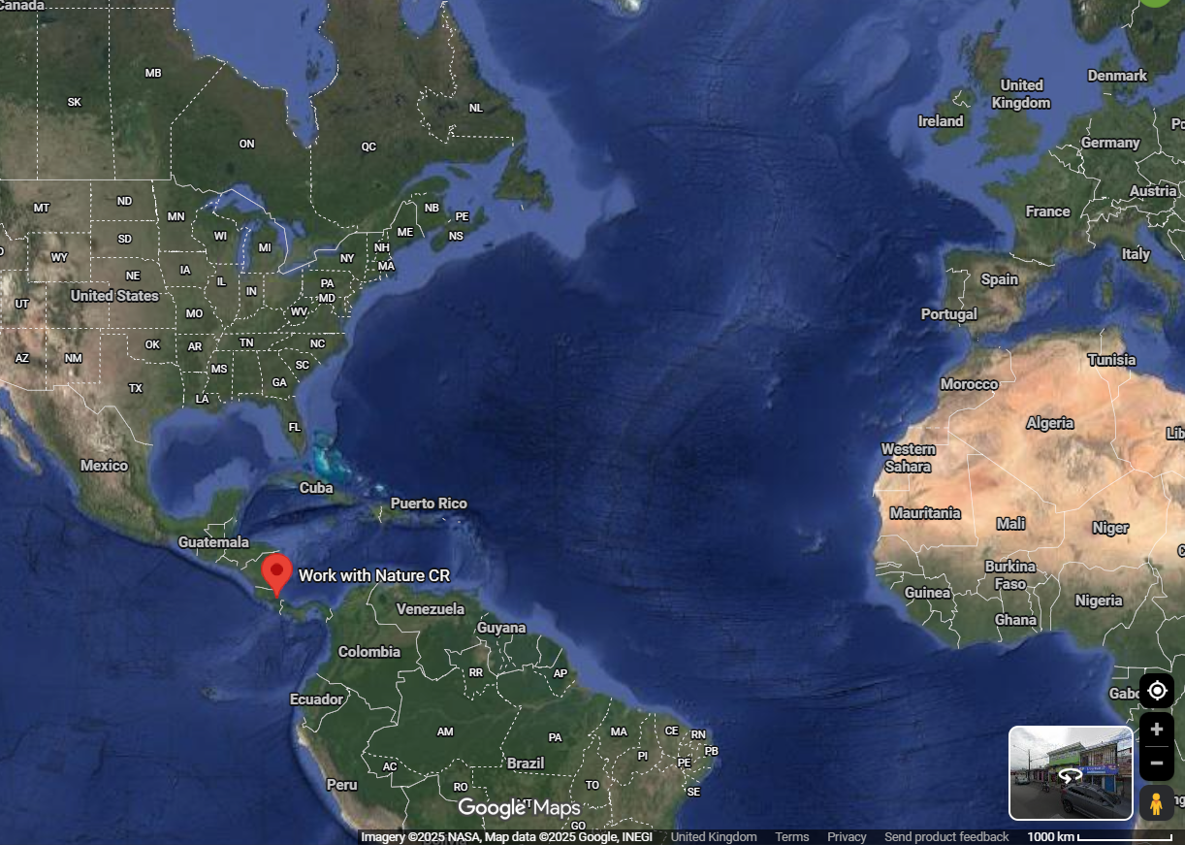
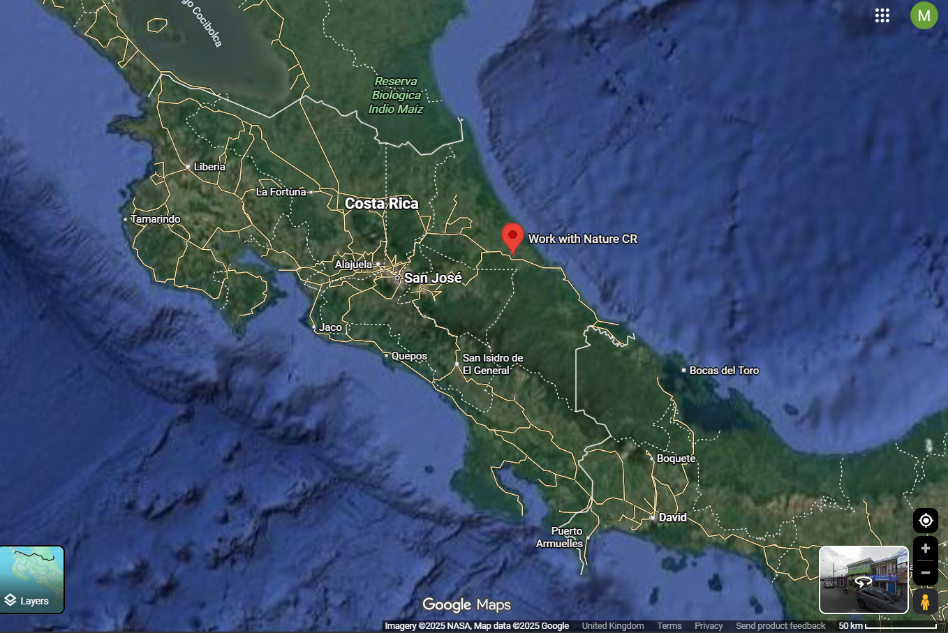
Work With Nature Costa Rica
Notes:
Work with Nature (WN) manages approximately 289 hectares of largely secondary rainforest with different land use histories:
old growth forest, regenerated but selective logged, naturally regenerated, actively reforested and Vochysia plantation

Slide 3
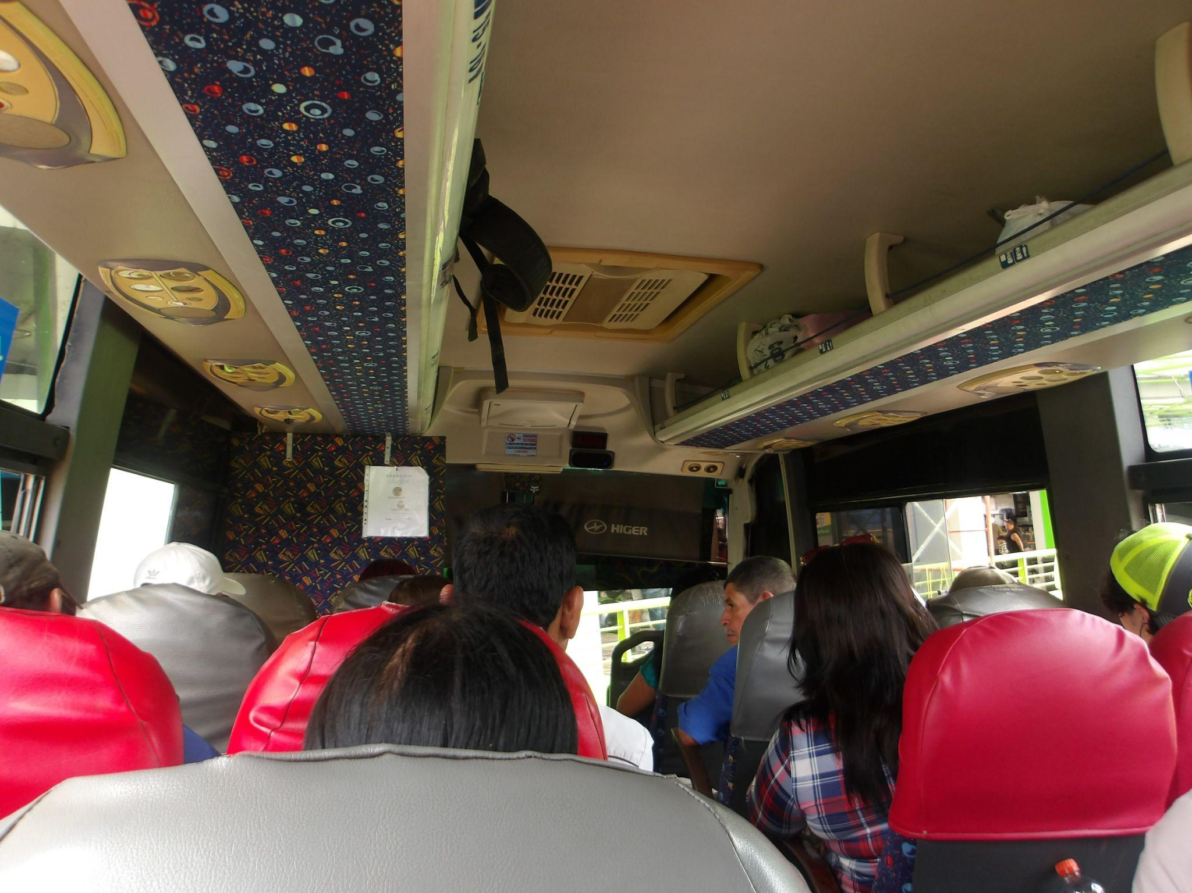
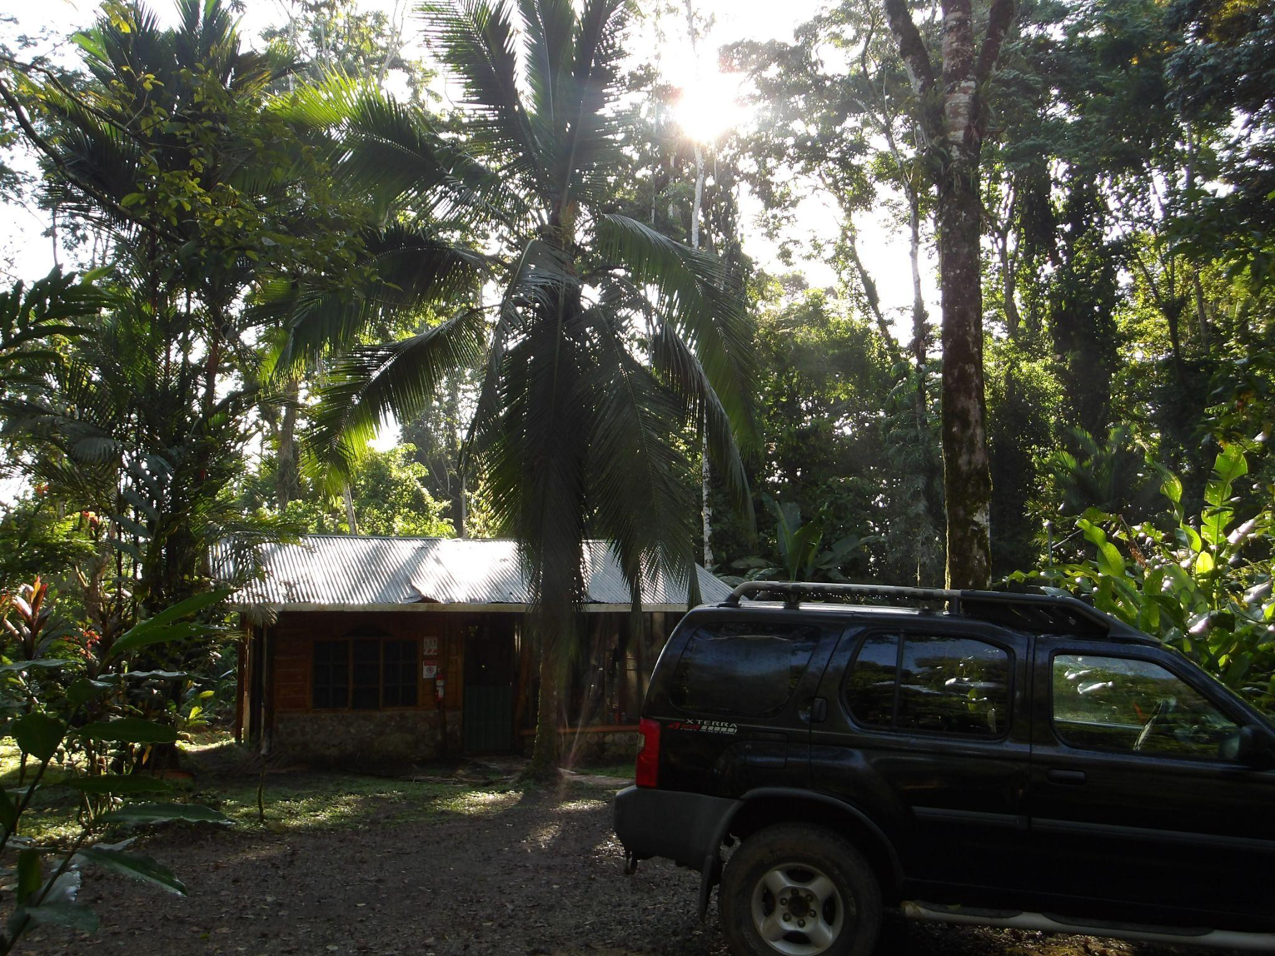
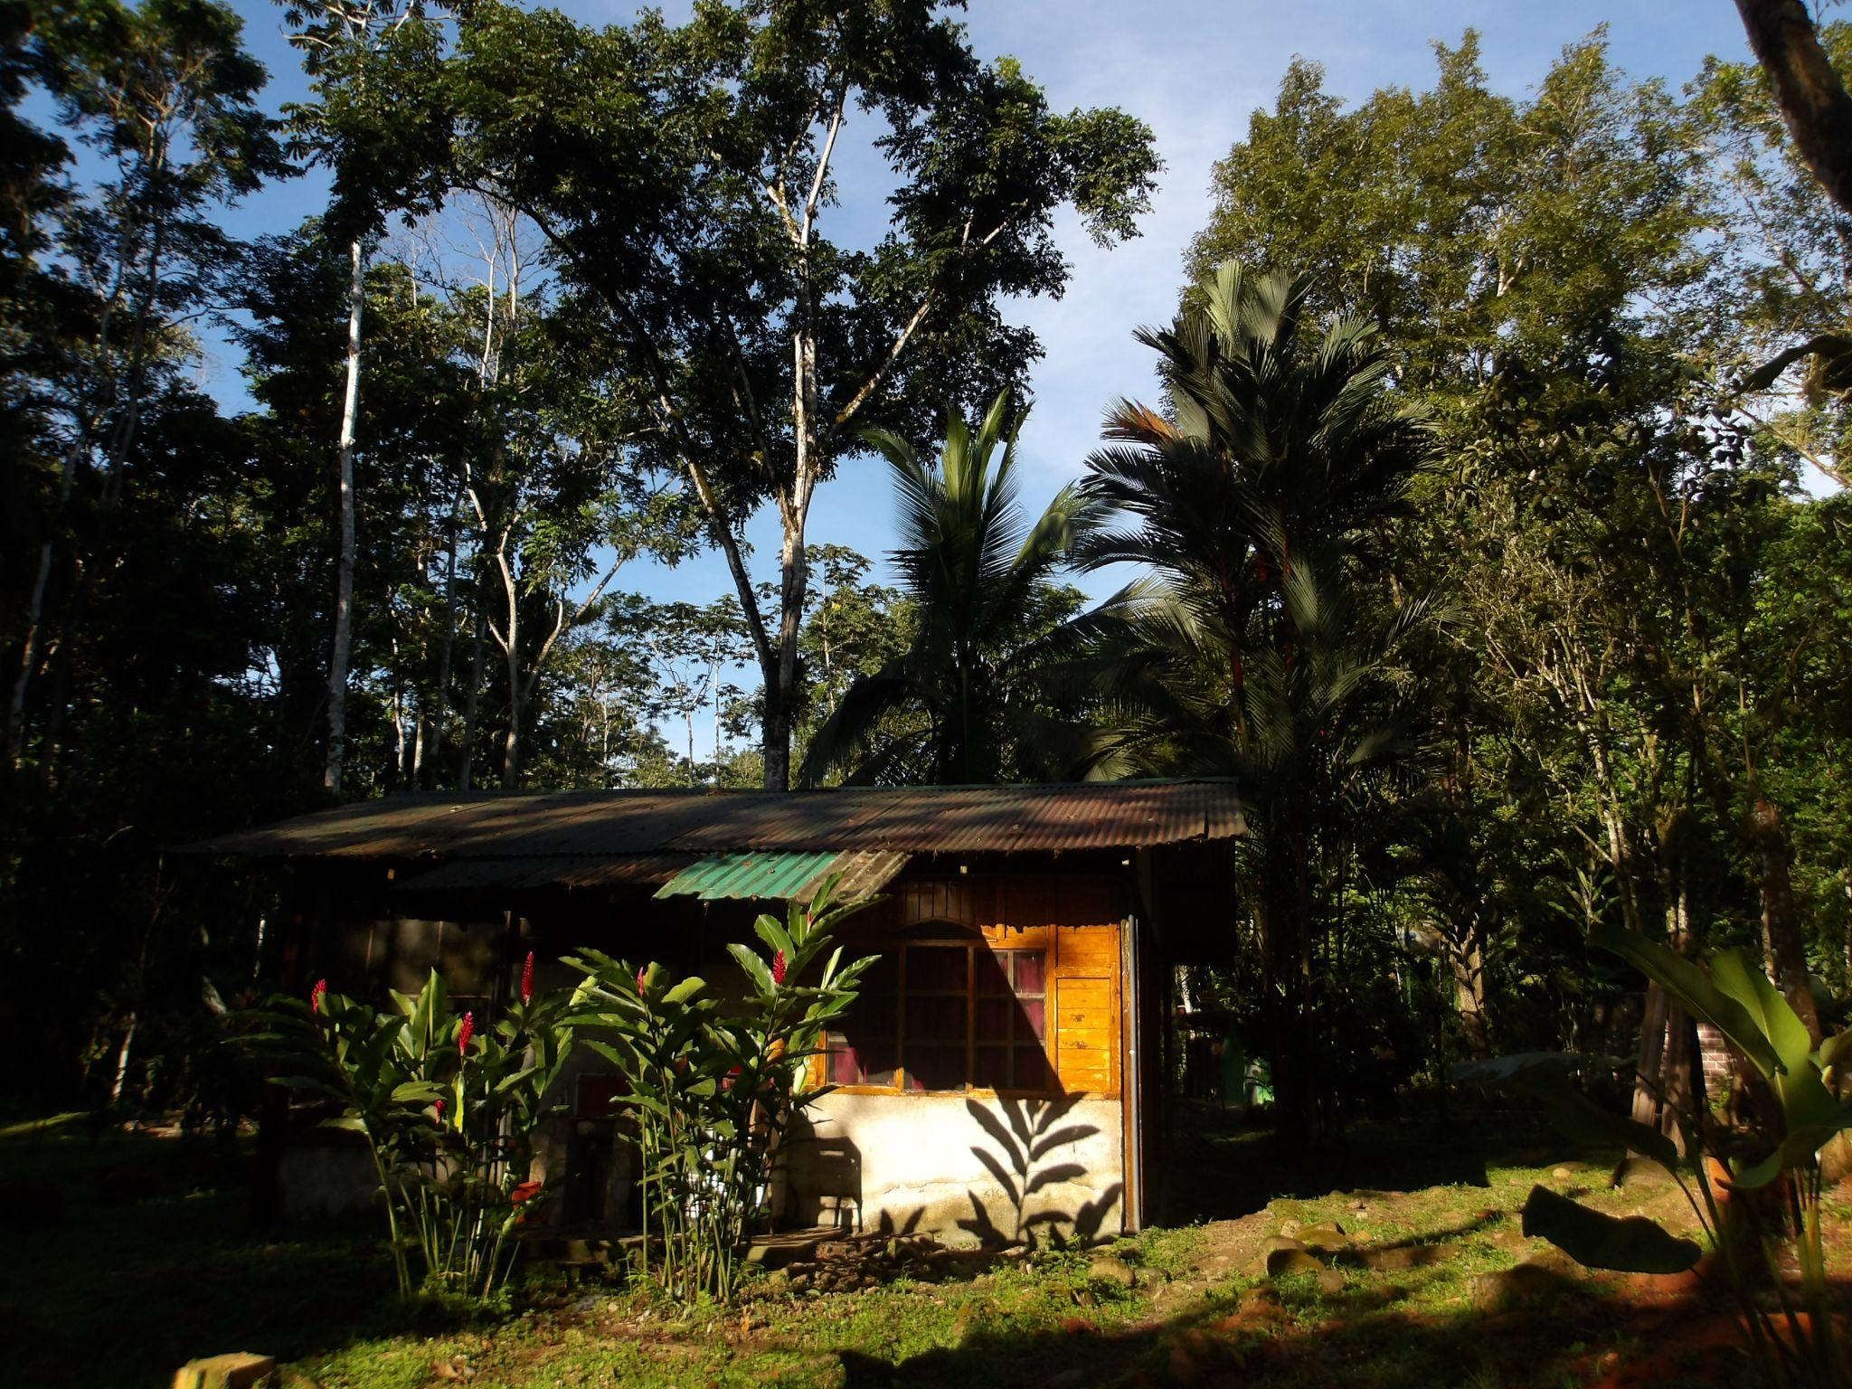
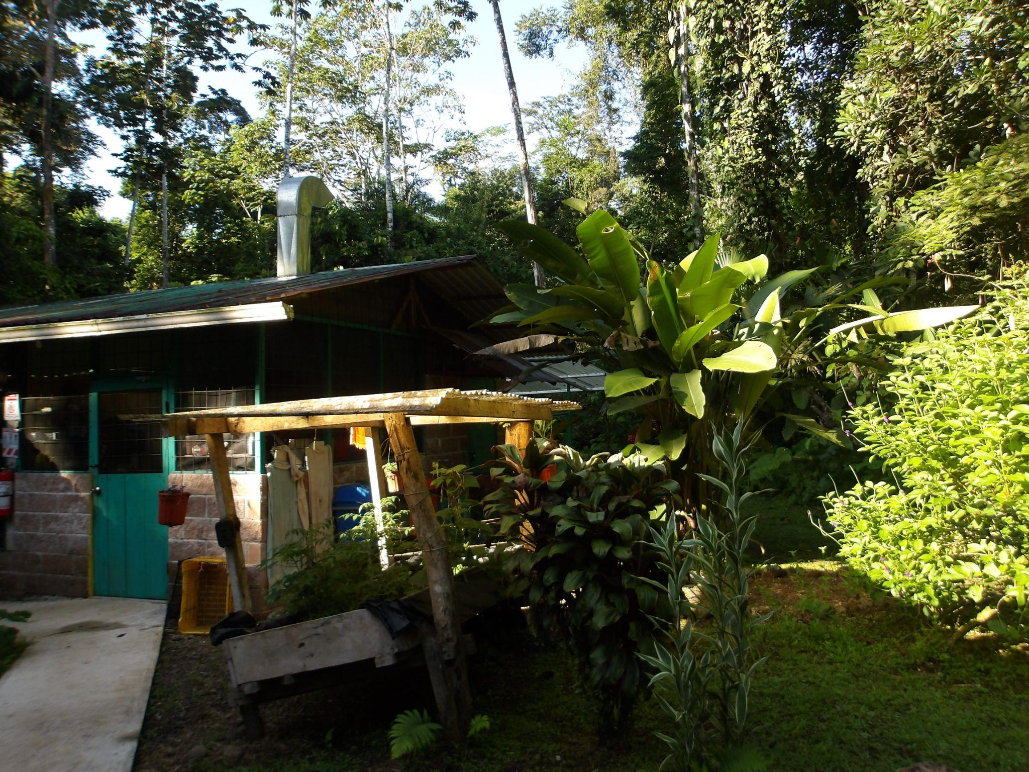
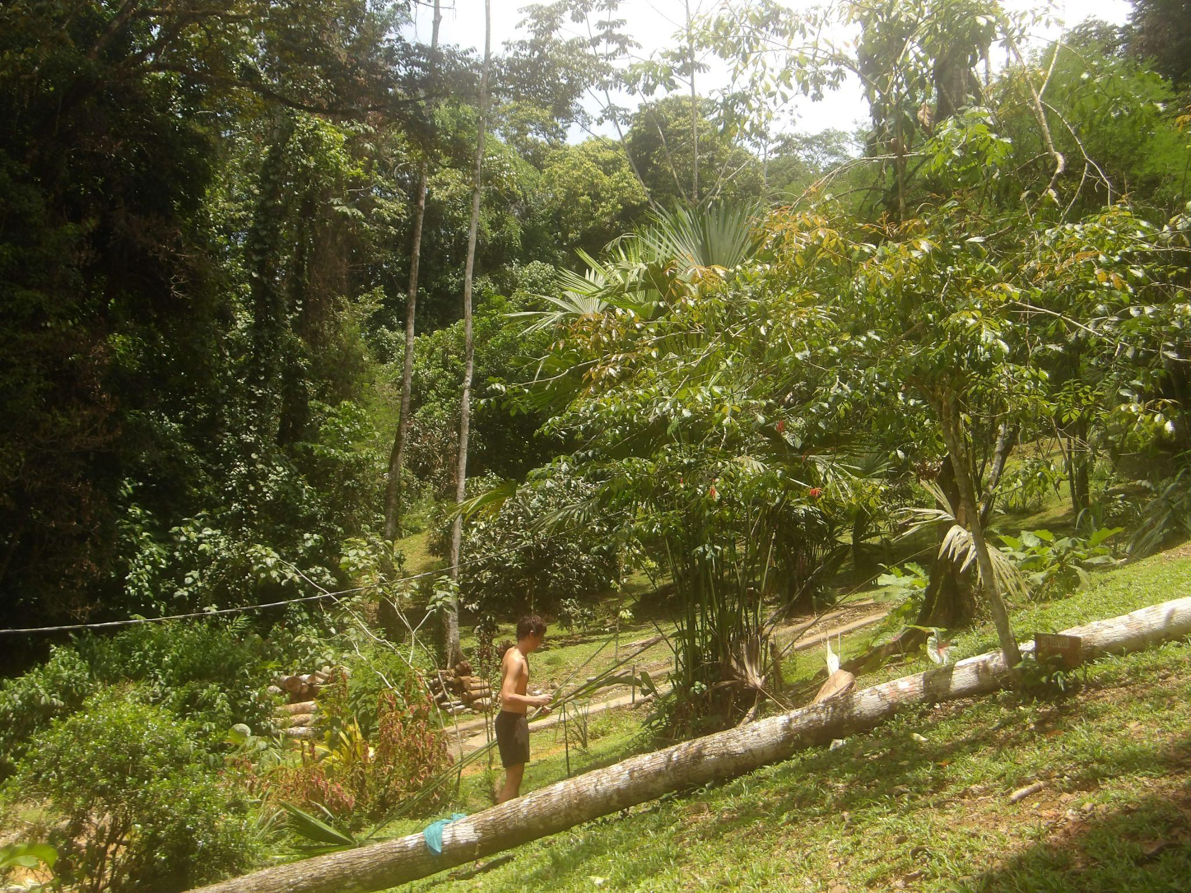
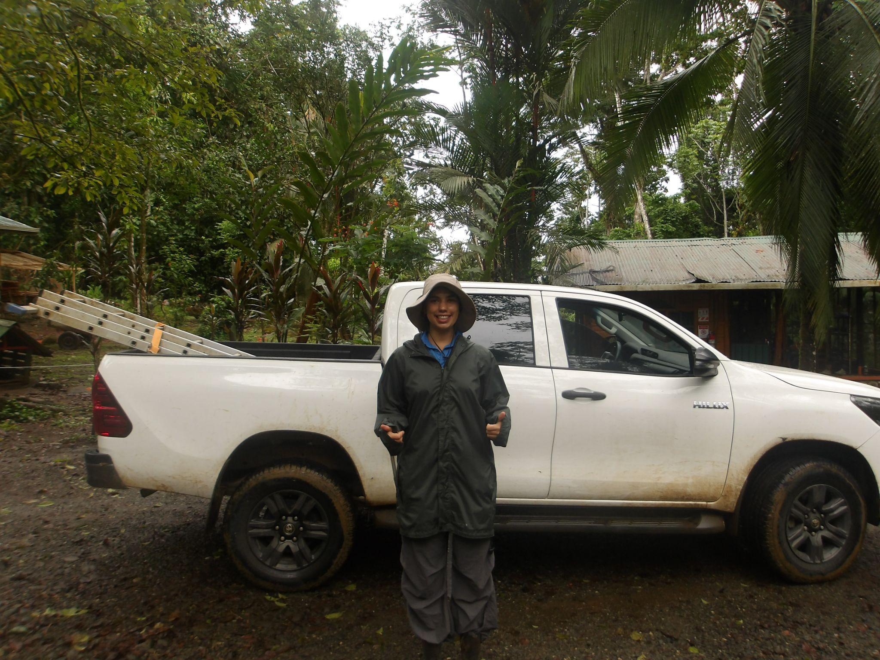
The Work With Nature Foundation

Slide 4
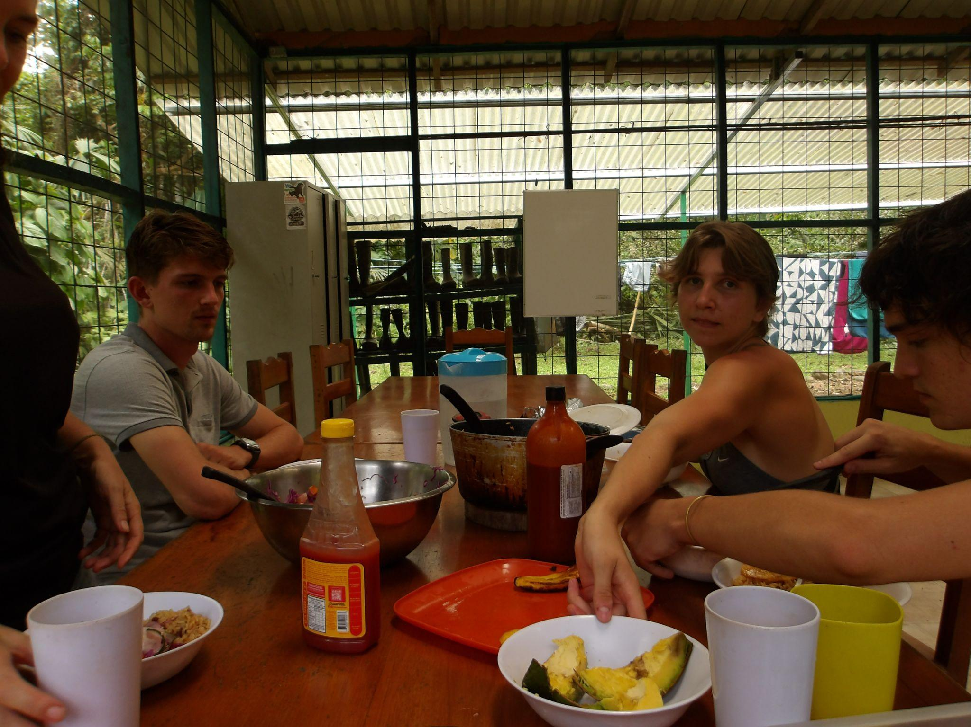
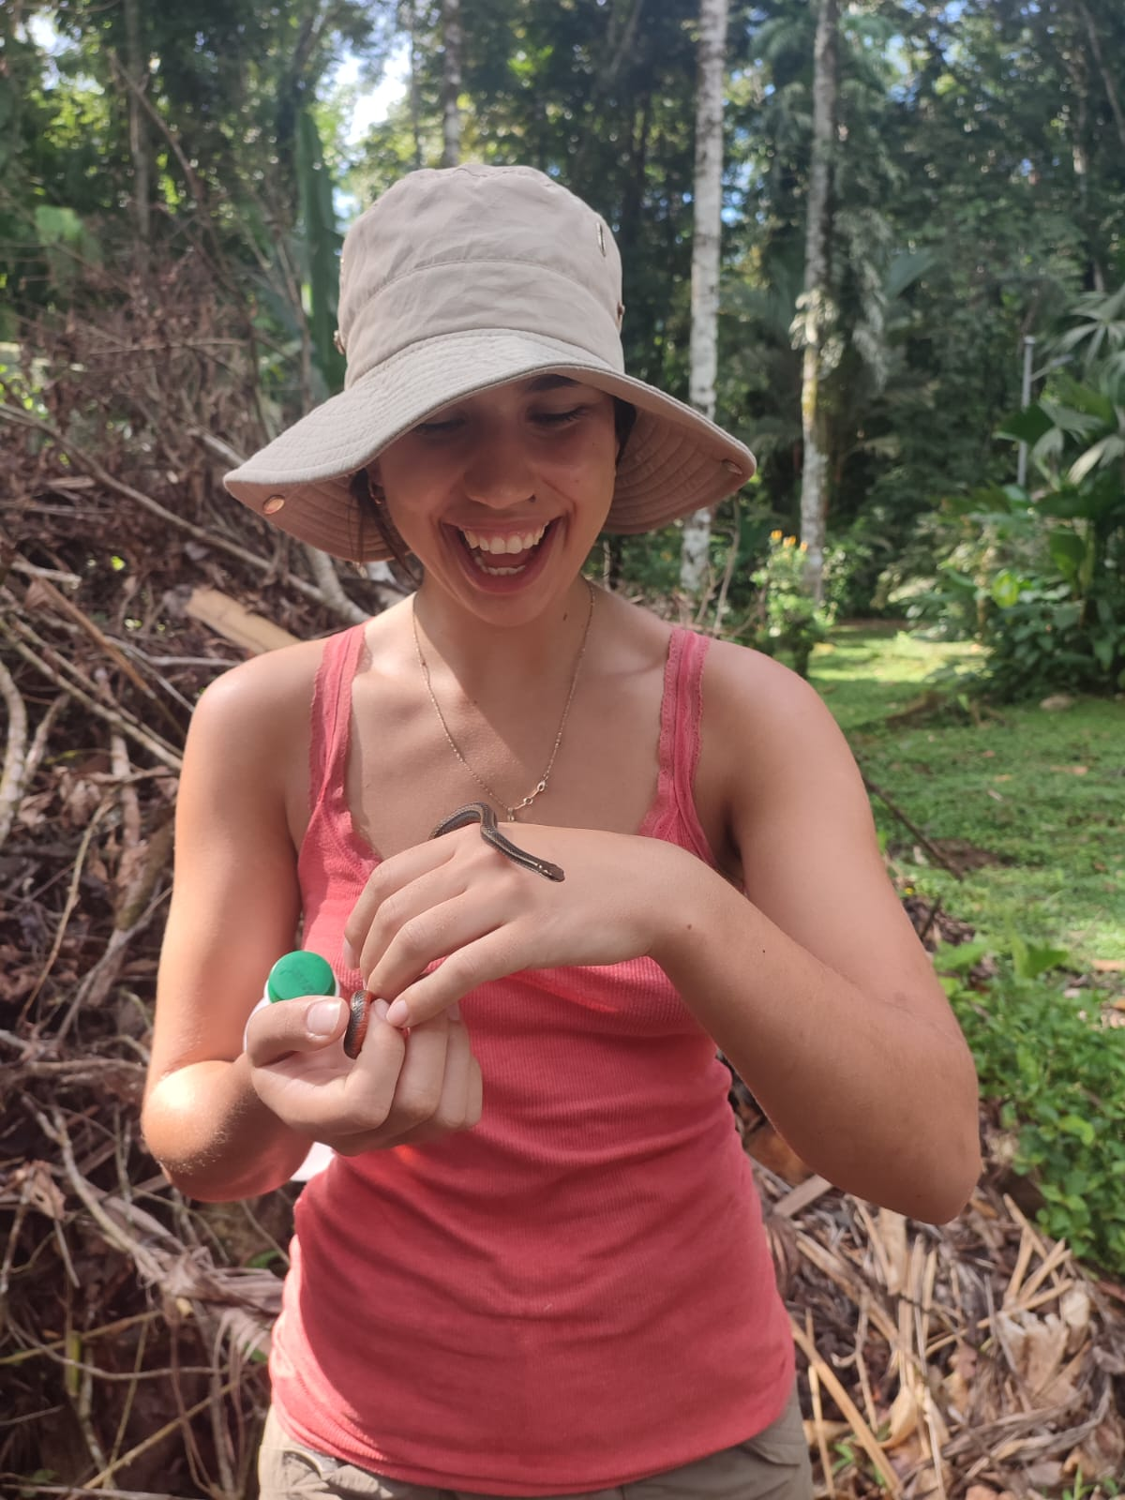
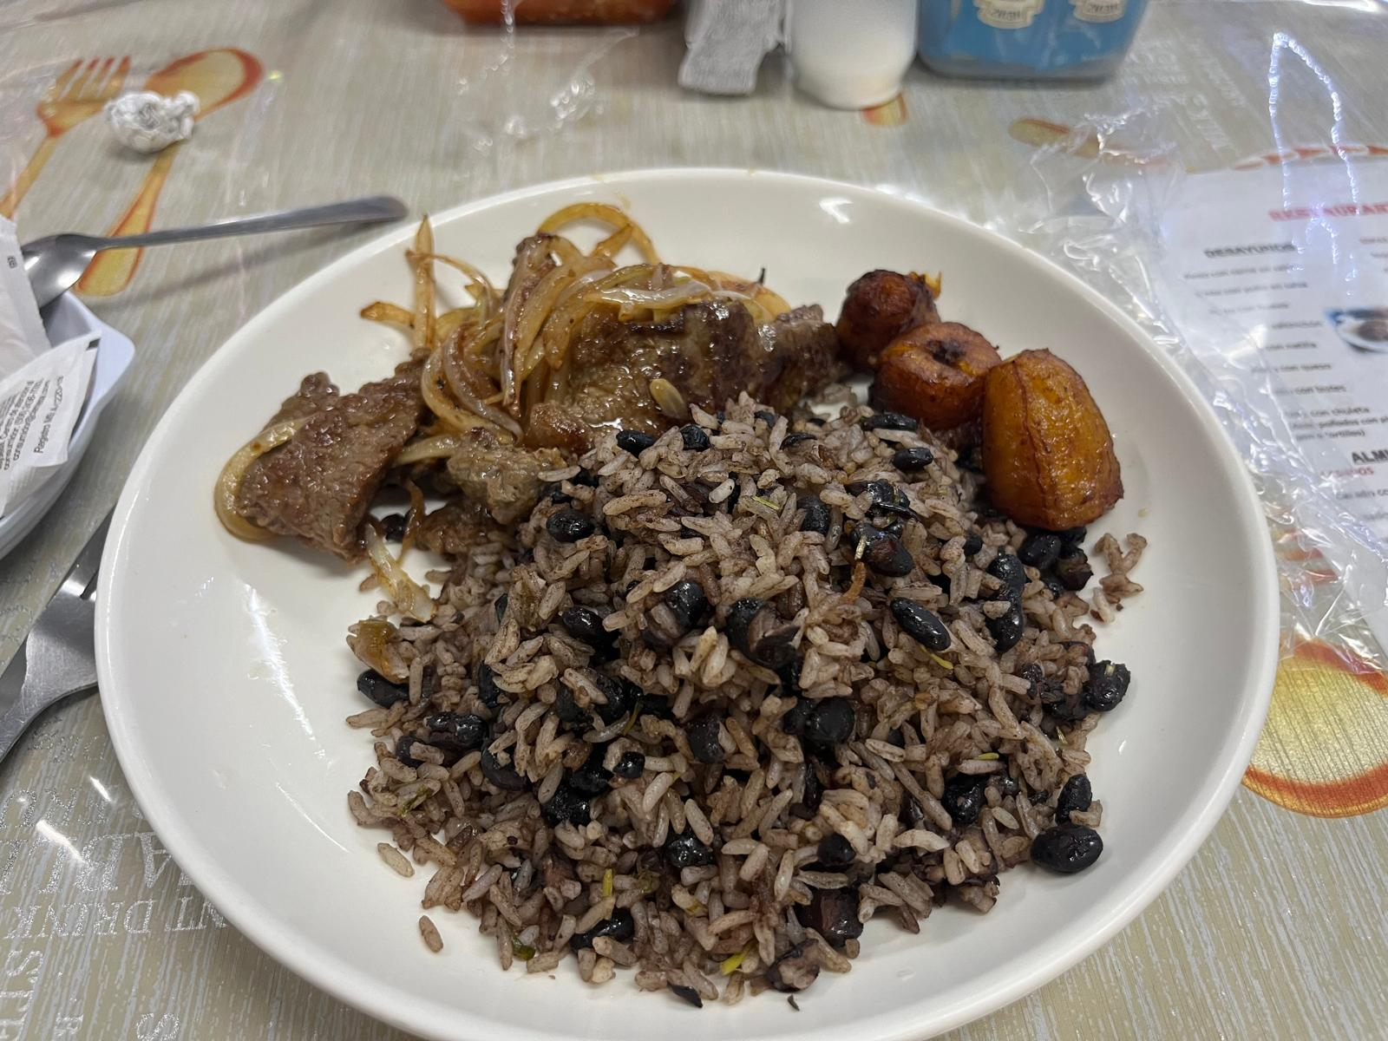
Life at WWN CR

Slide 5
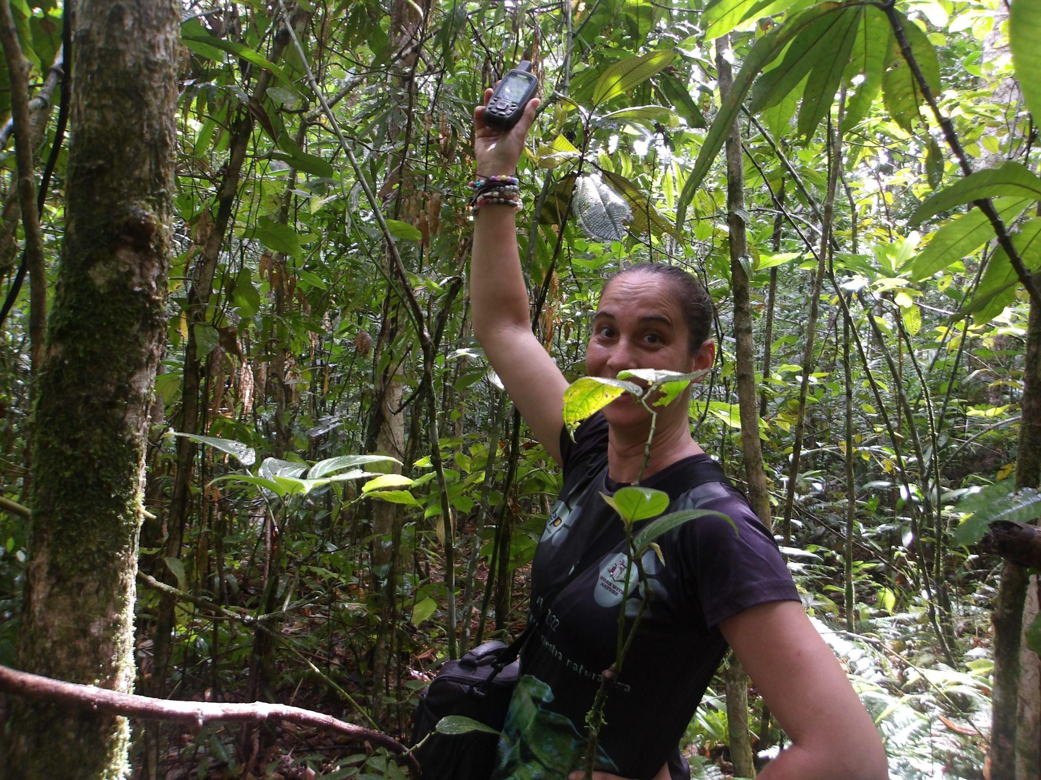
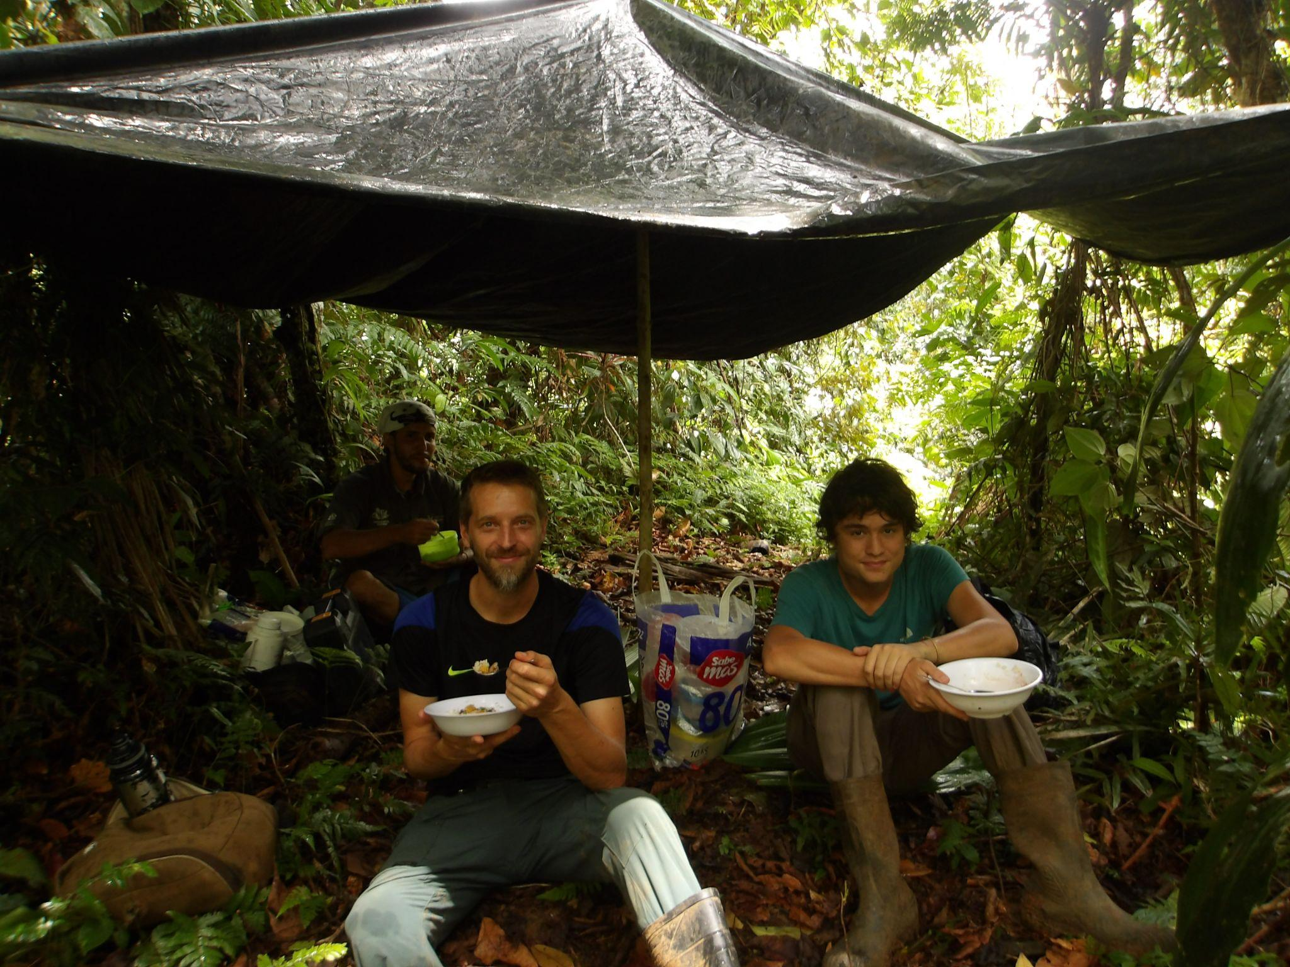
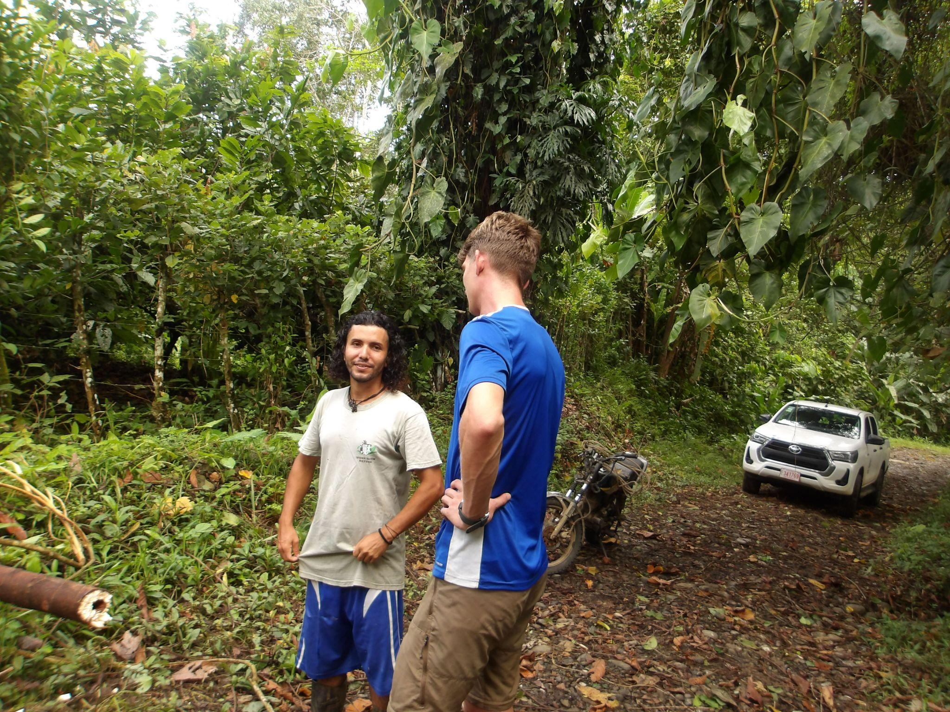
The Team
Gerald (Rainforest Guide)
Hannake (Research Manager)
Marteen (Research Manager)
Mattihis (Research Assistant)

Slide 6
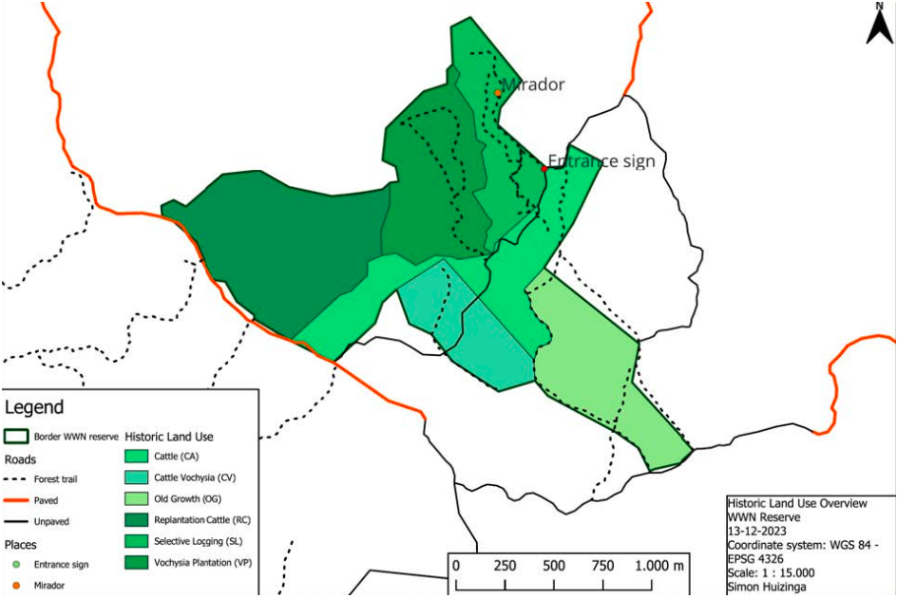
The Effects of Historical Land Use on Biodiversity and Biomass (ELUBB) Project
Project Aims:
Analyse changes in forest species composition, species diversity and biomass per LUH over time;
Evaluate differences in successional pathways between secondary forests with different LUHs;
Translate findings to effective strategies aiming to promote tropical forest conservation and regeneration, adjusting management practices to their LUH.

Slide 7
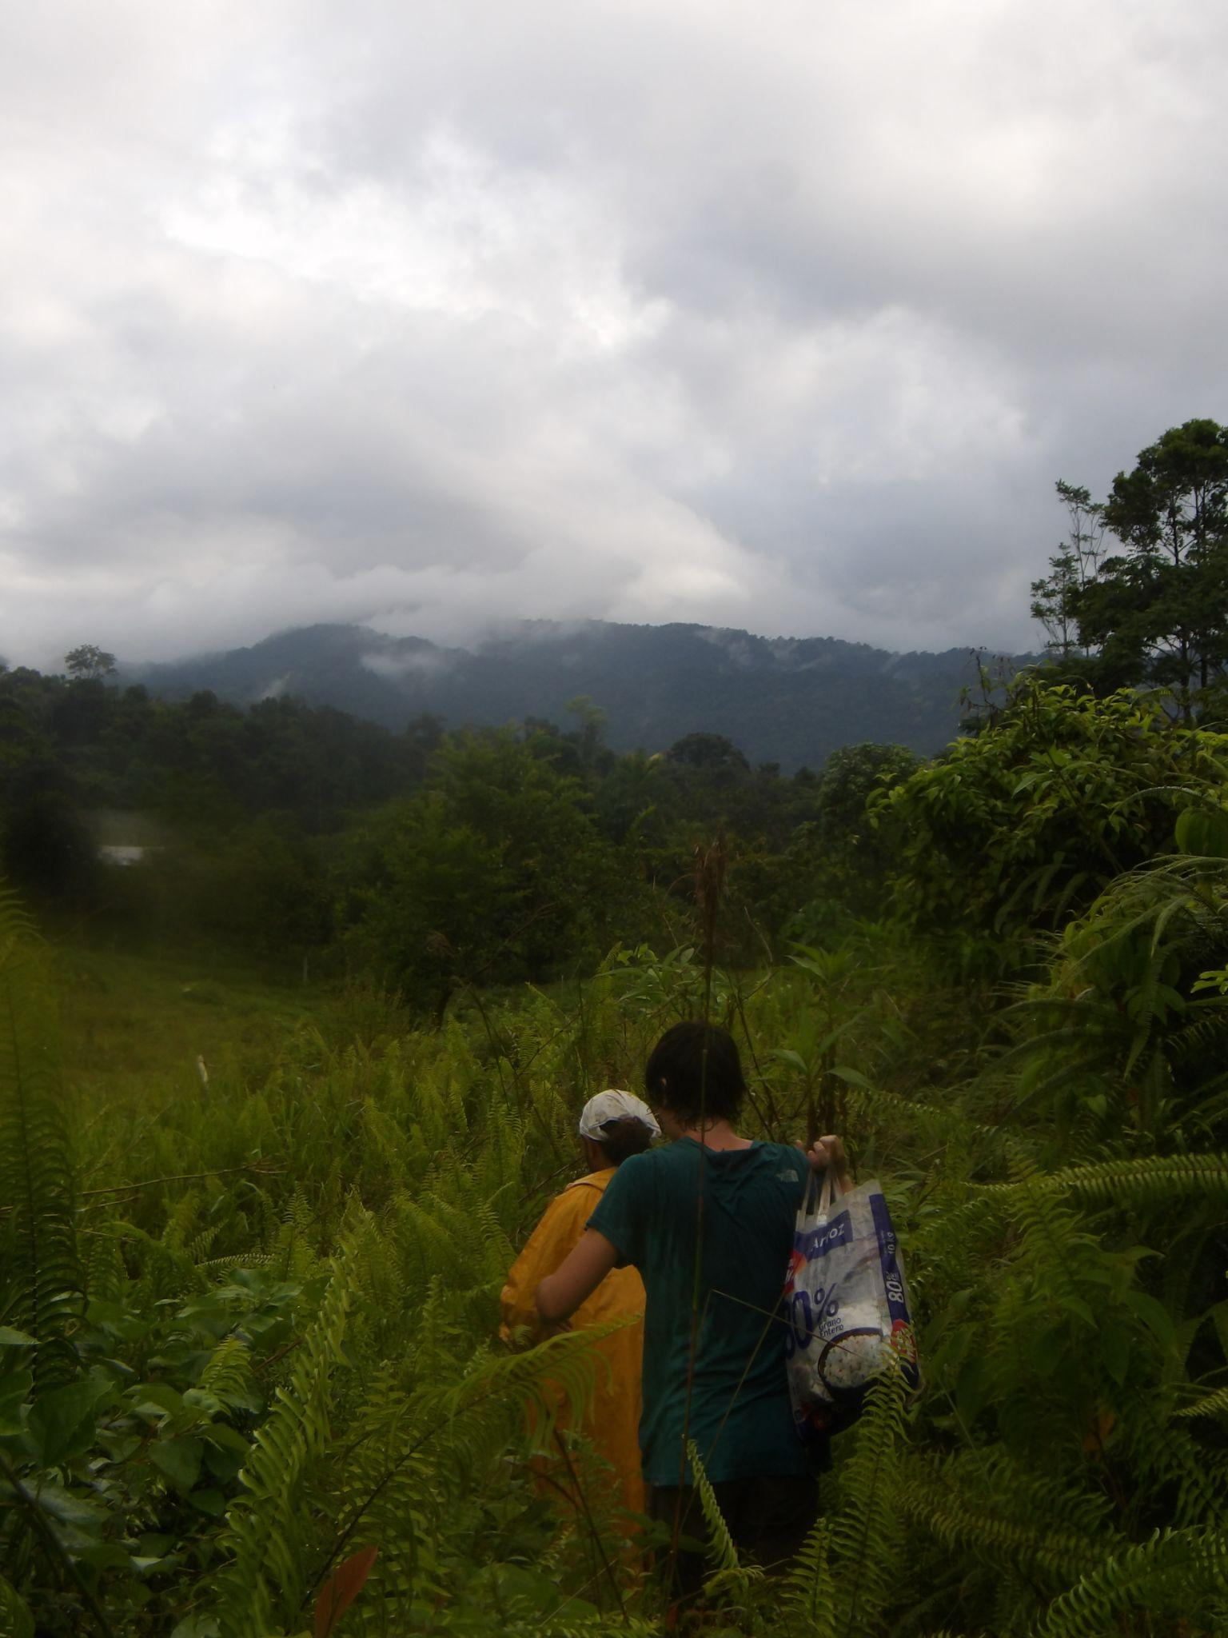
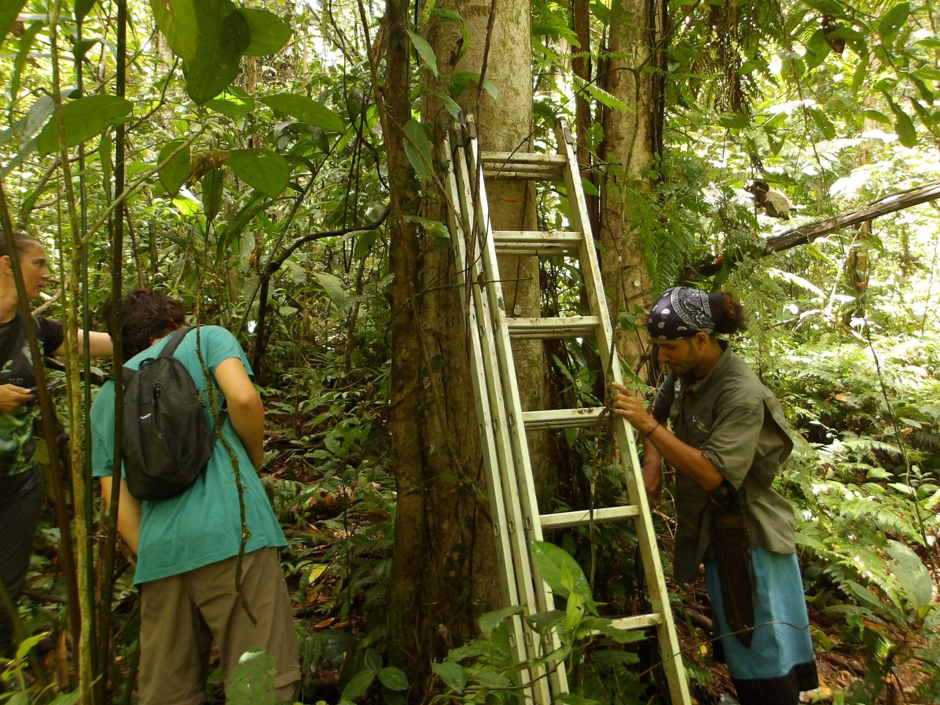
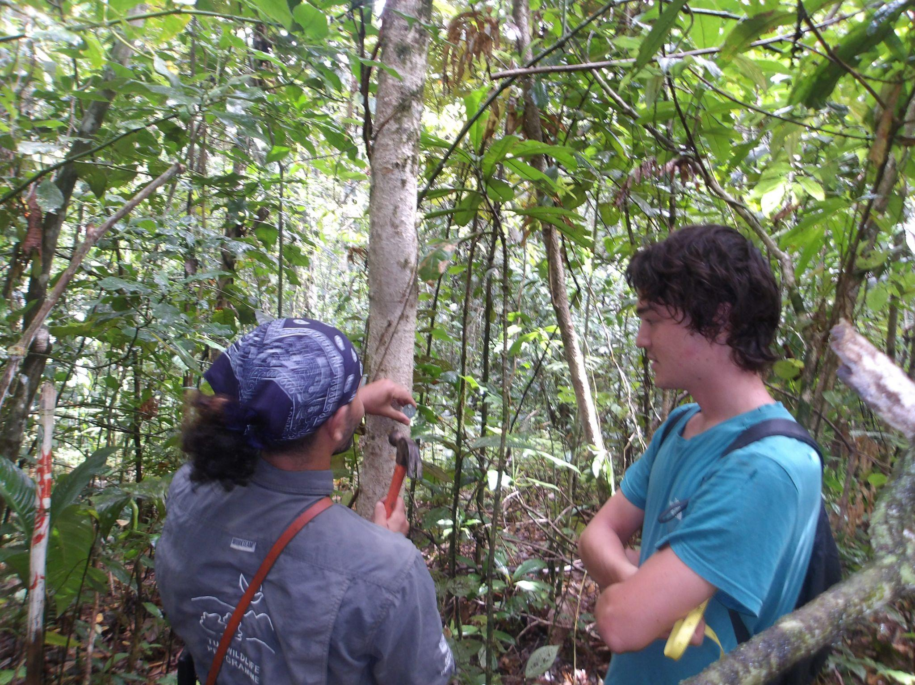
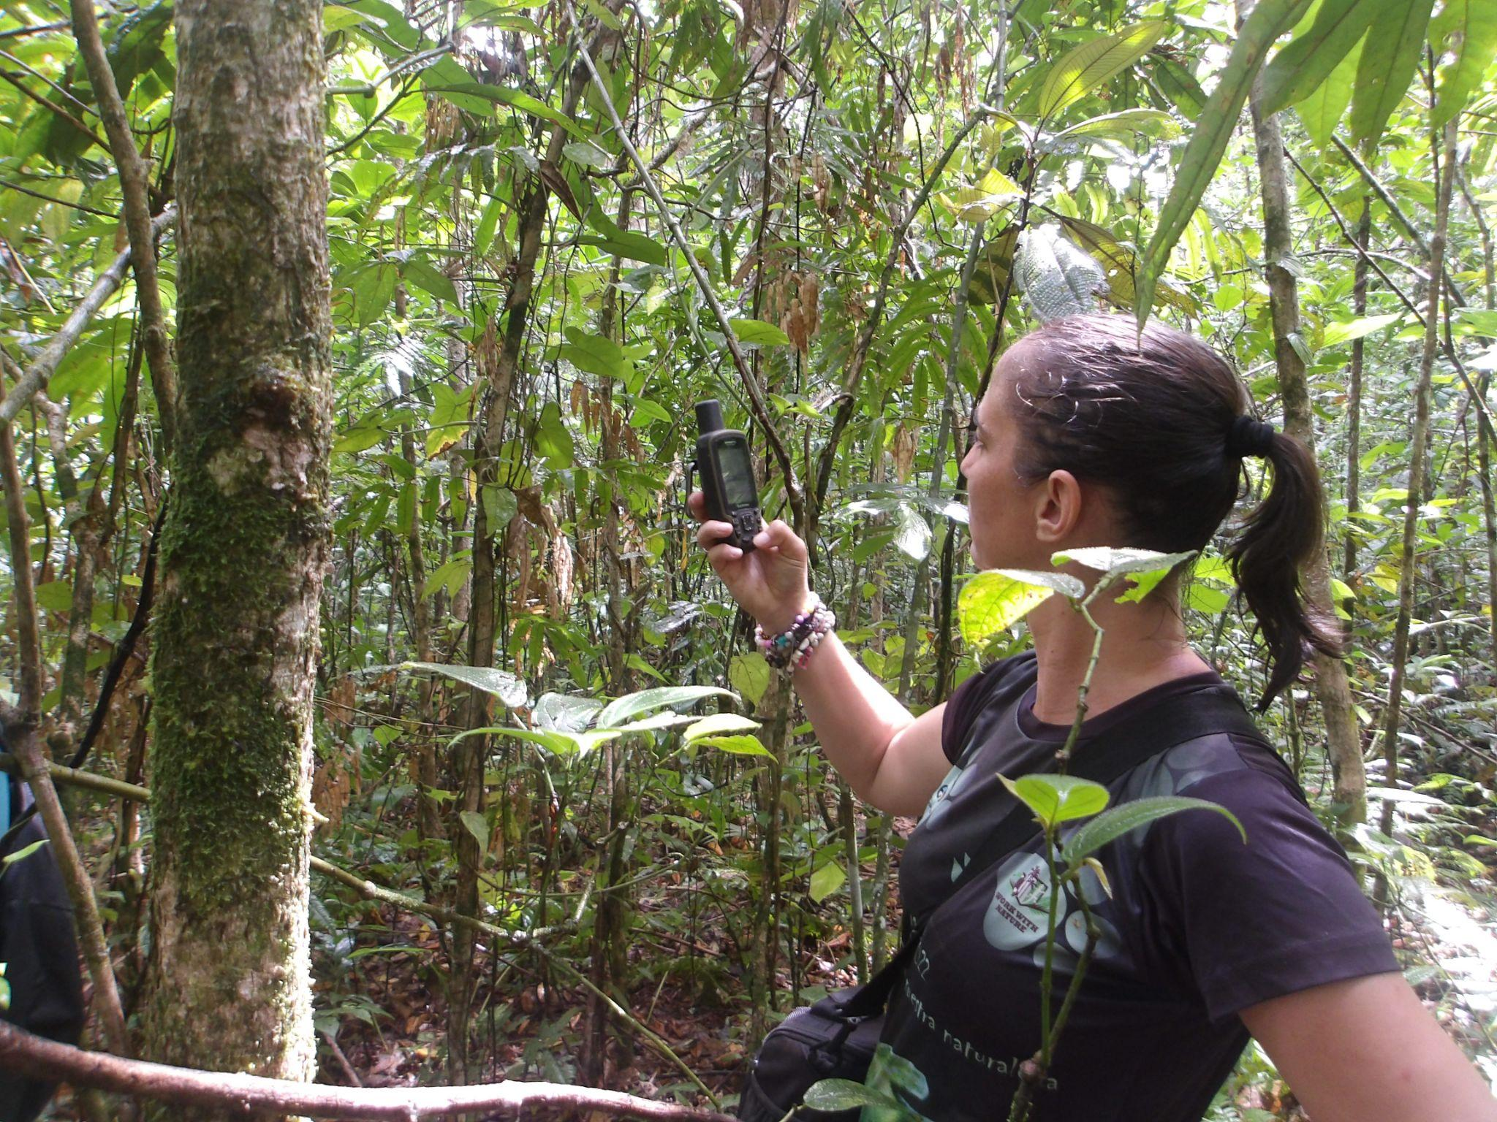
ELUBB data collection
Scouting suitable locations for a plot
Measuring the plot
Tree data collection (DBH, Leaf and bark samples)
GPS tracking

Slide 8
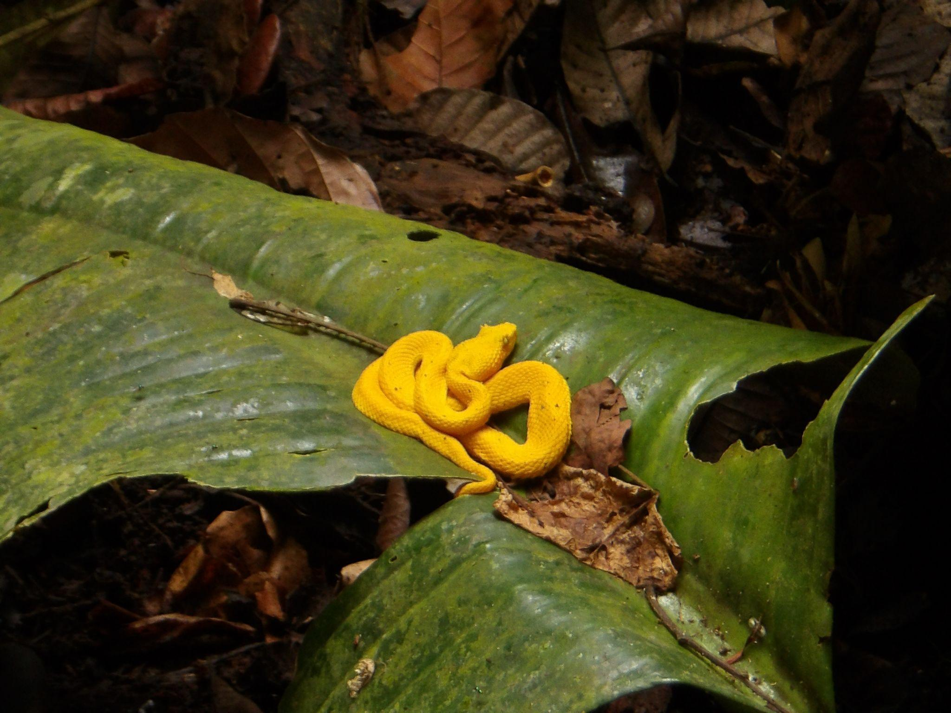
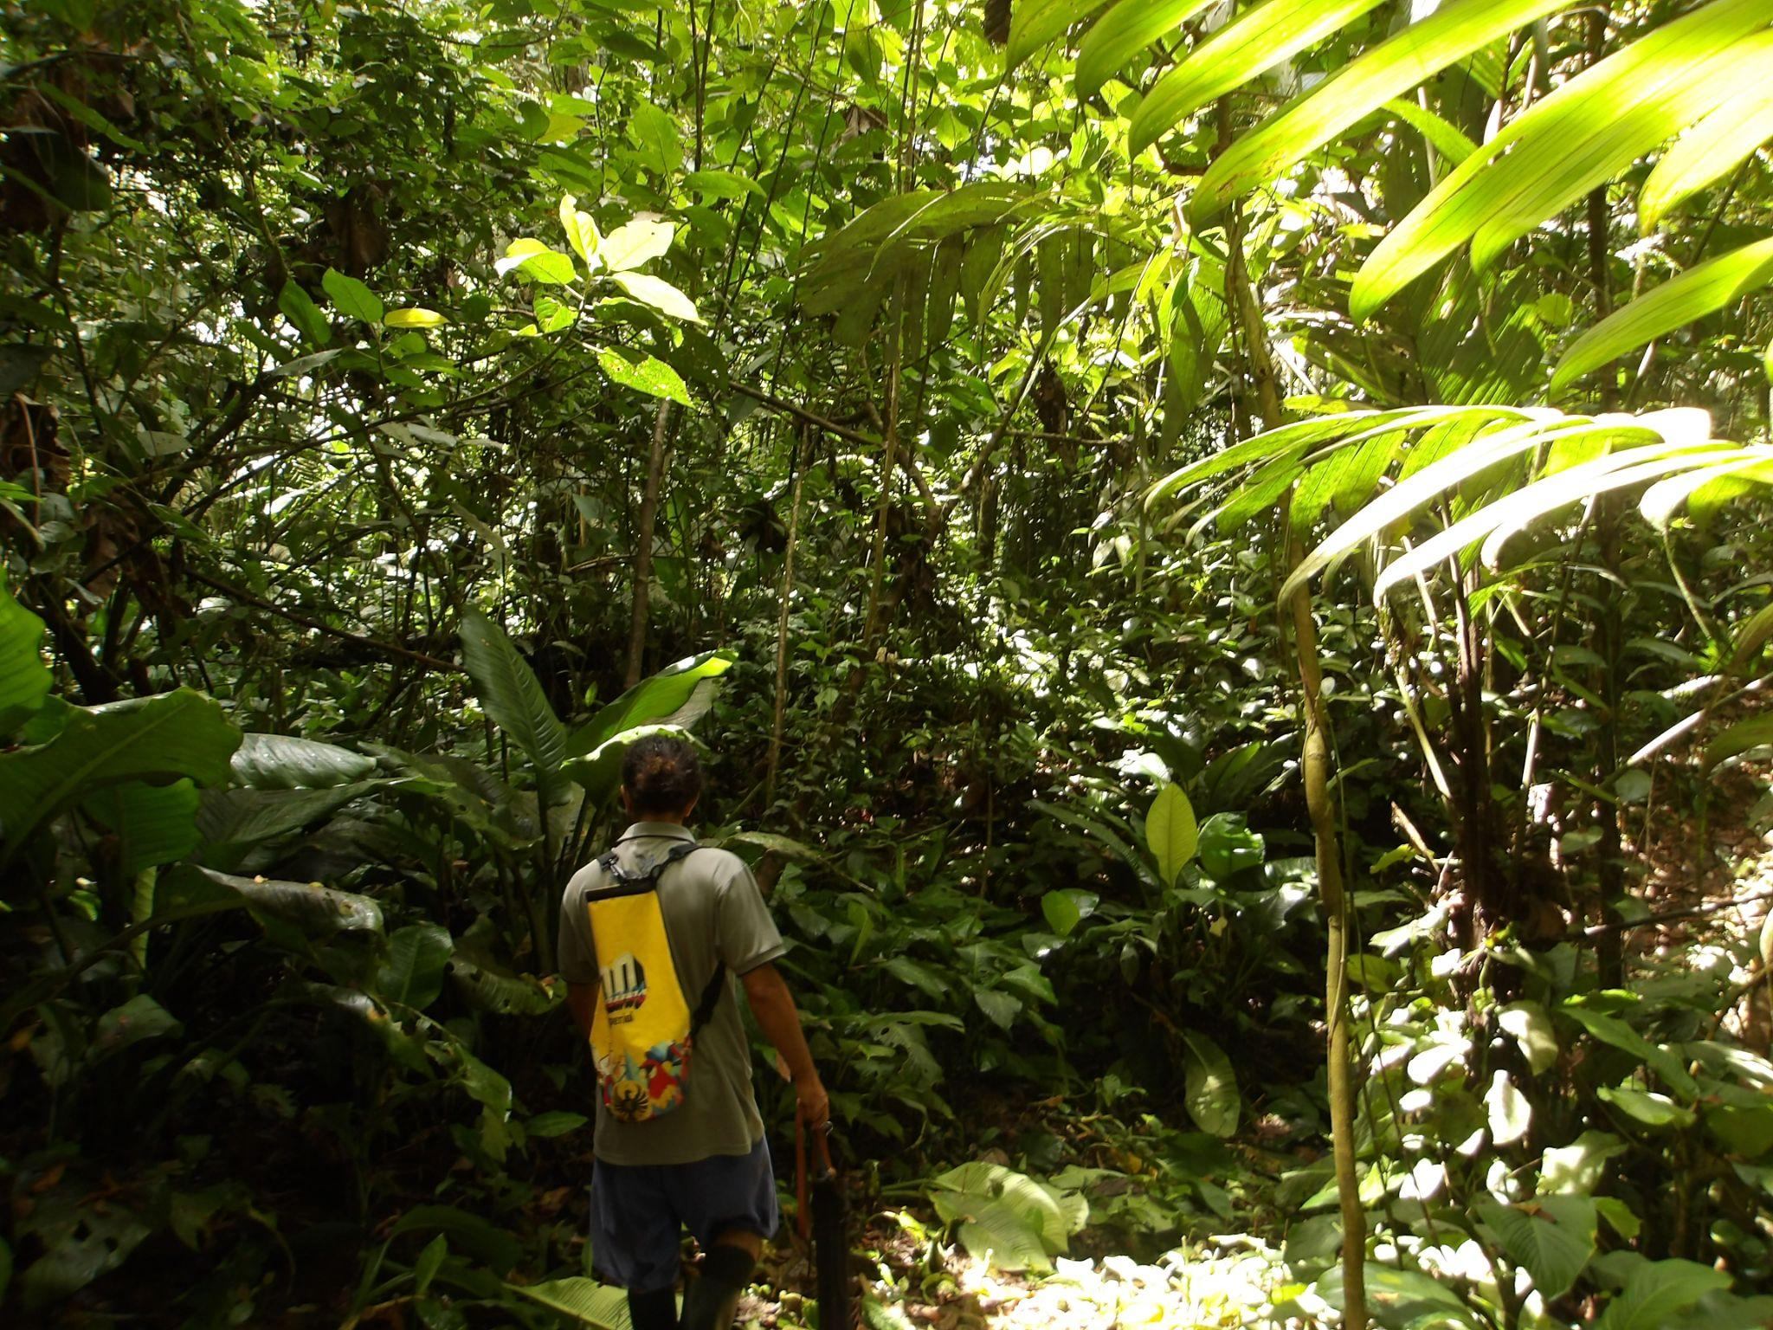
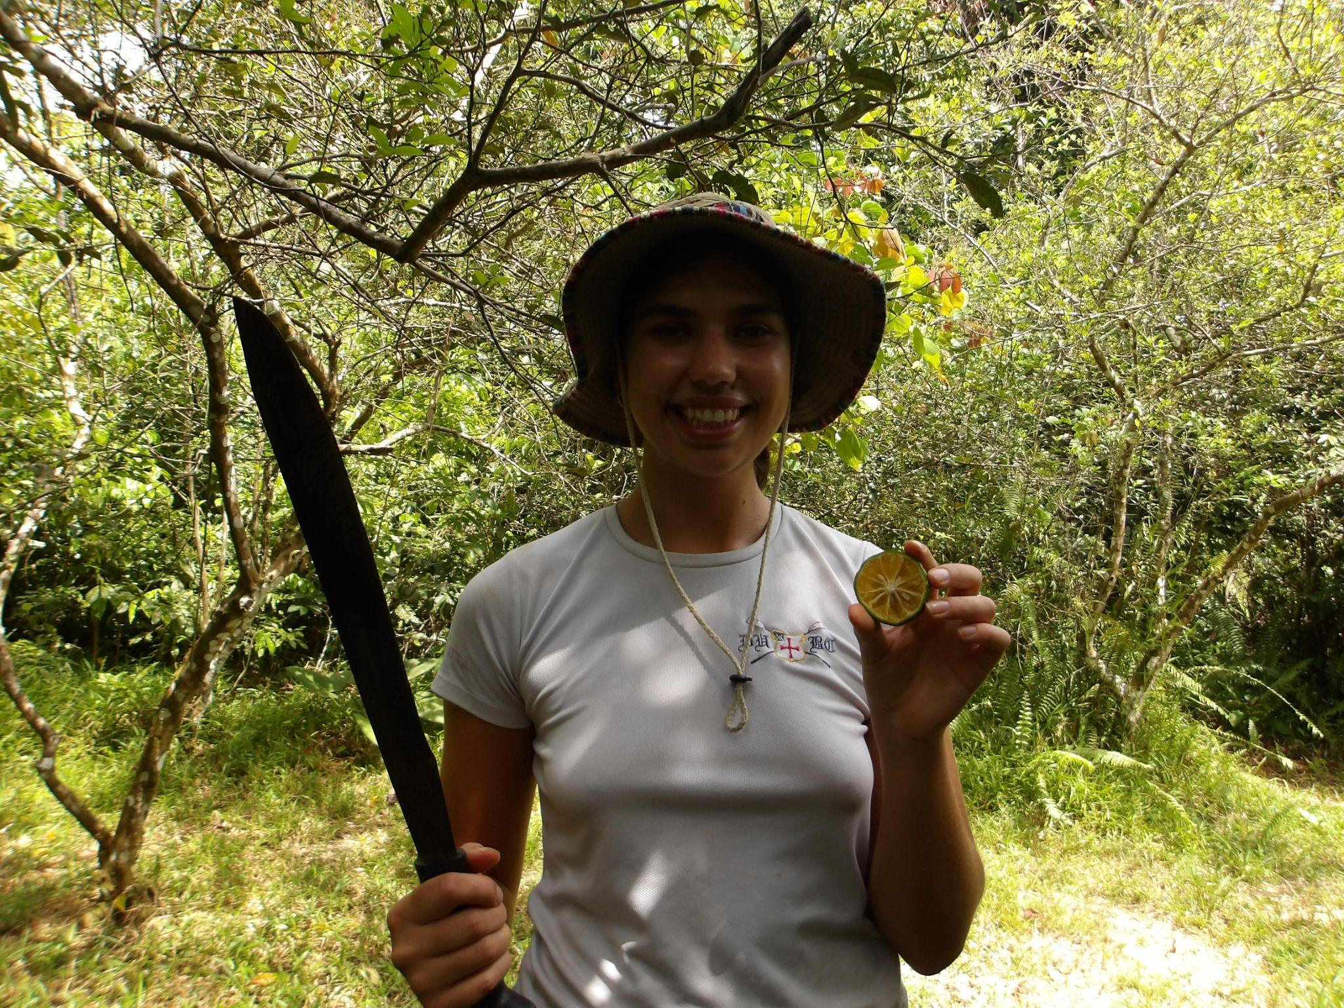
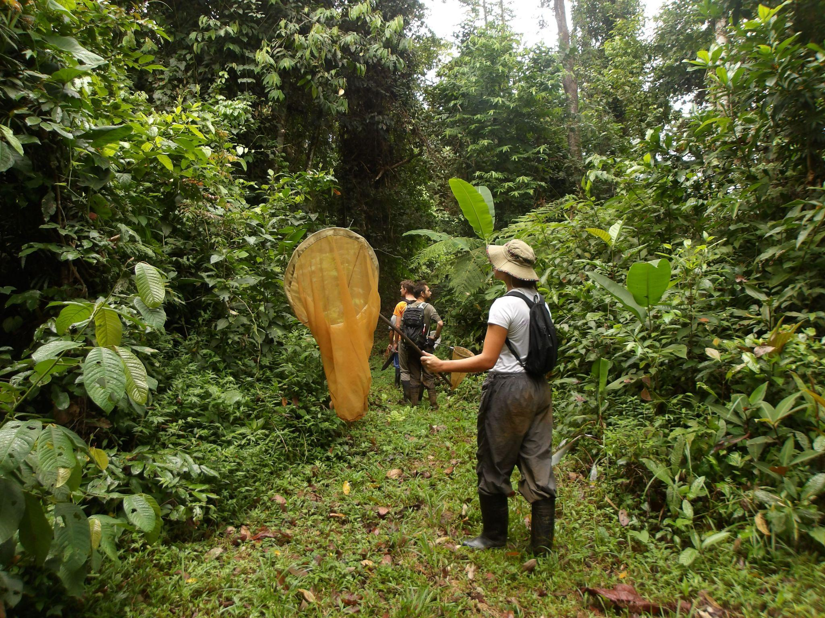
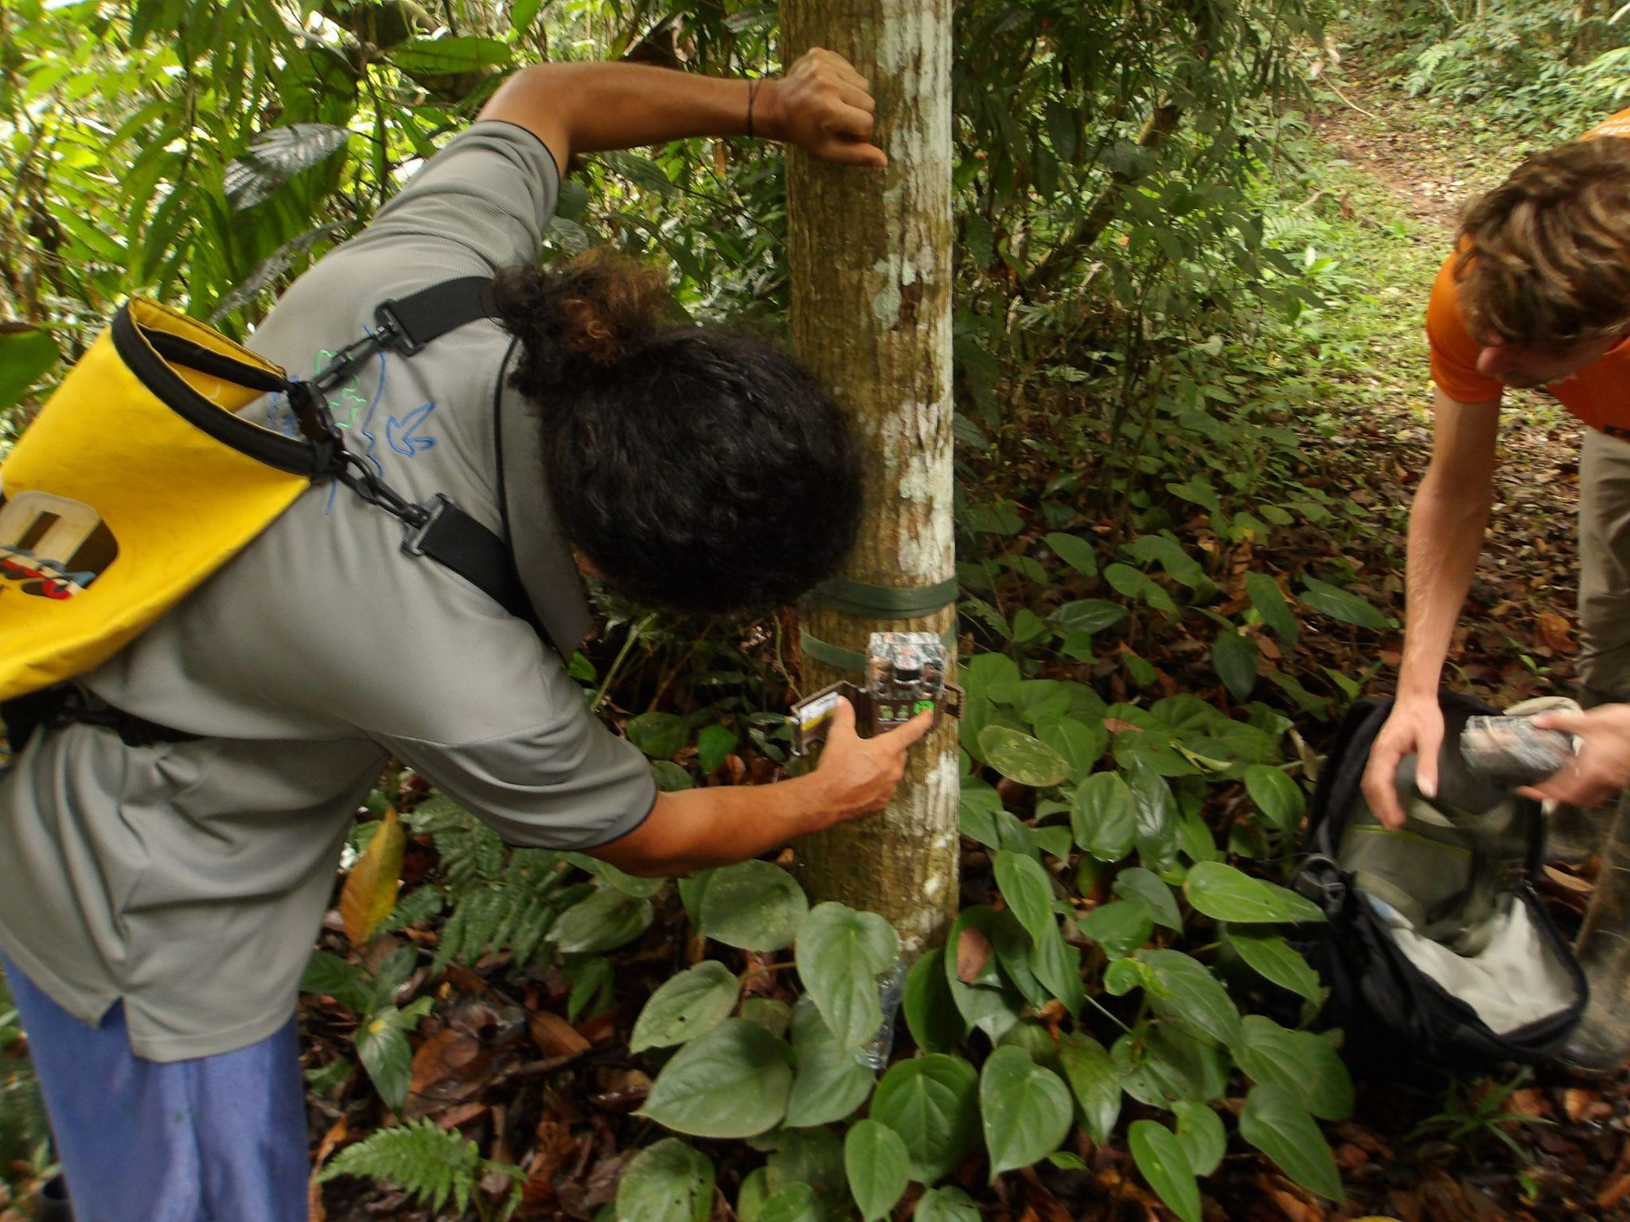
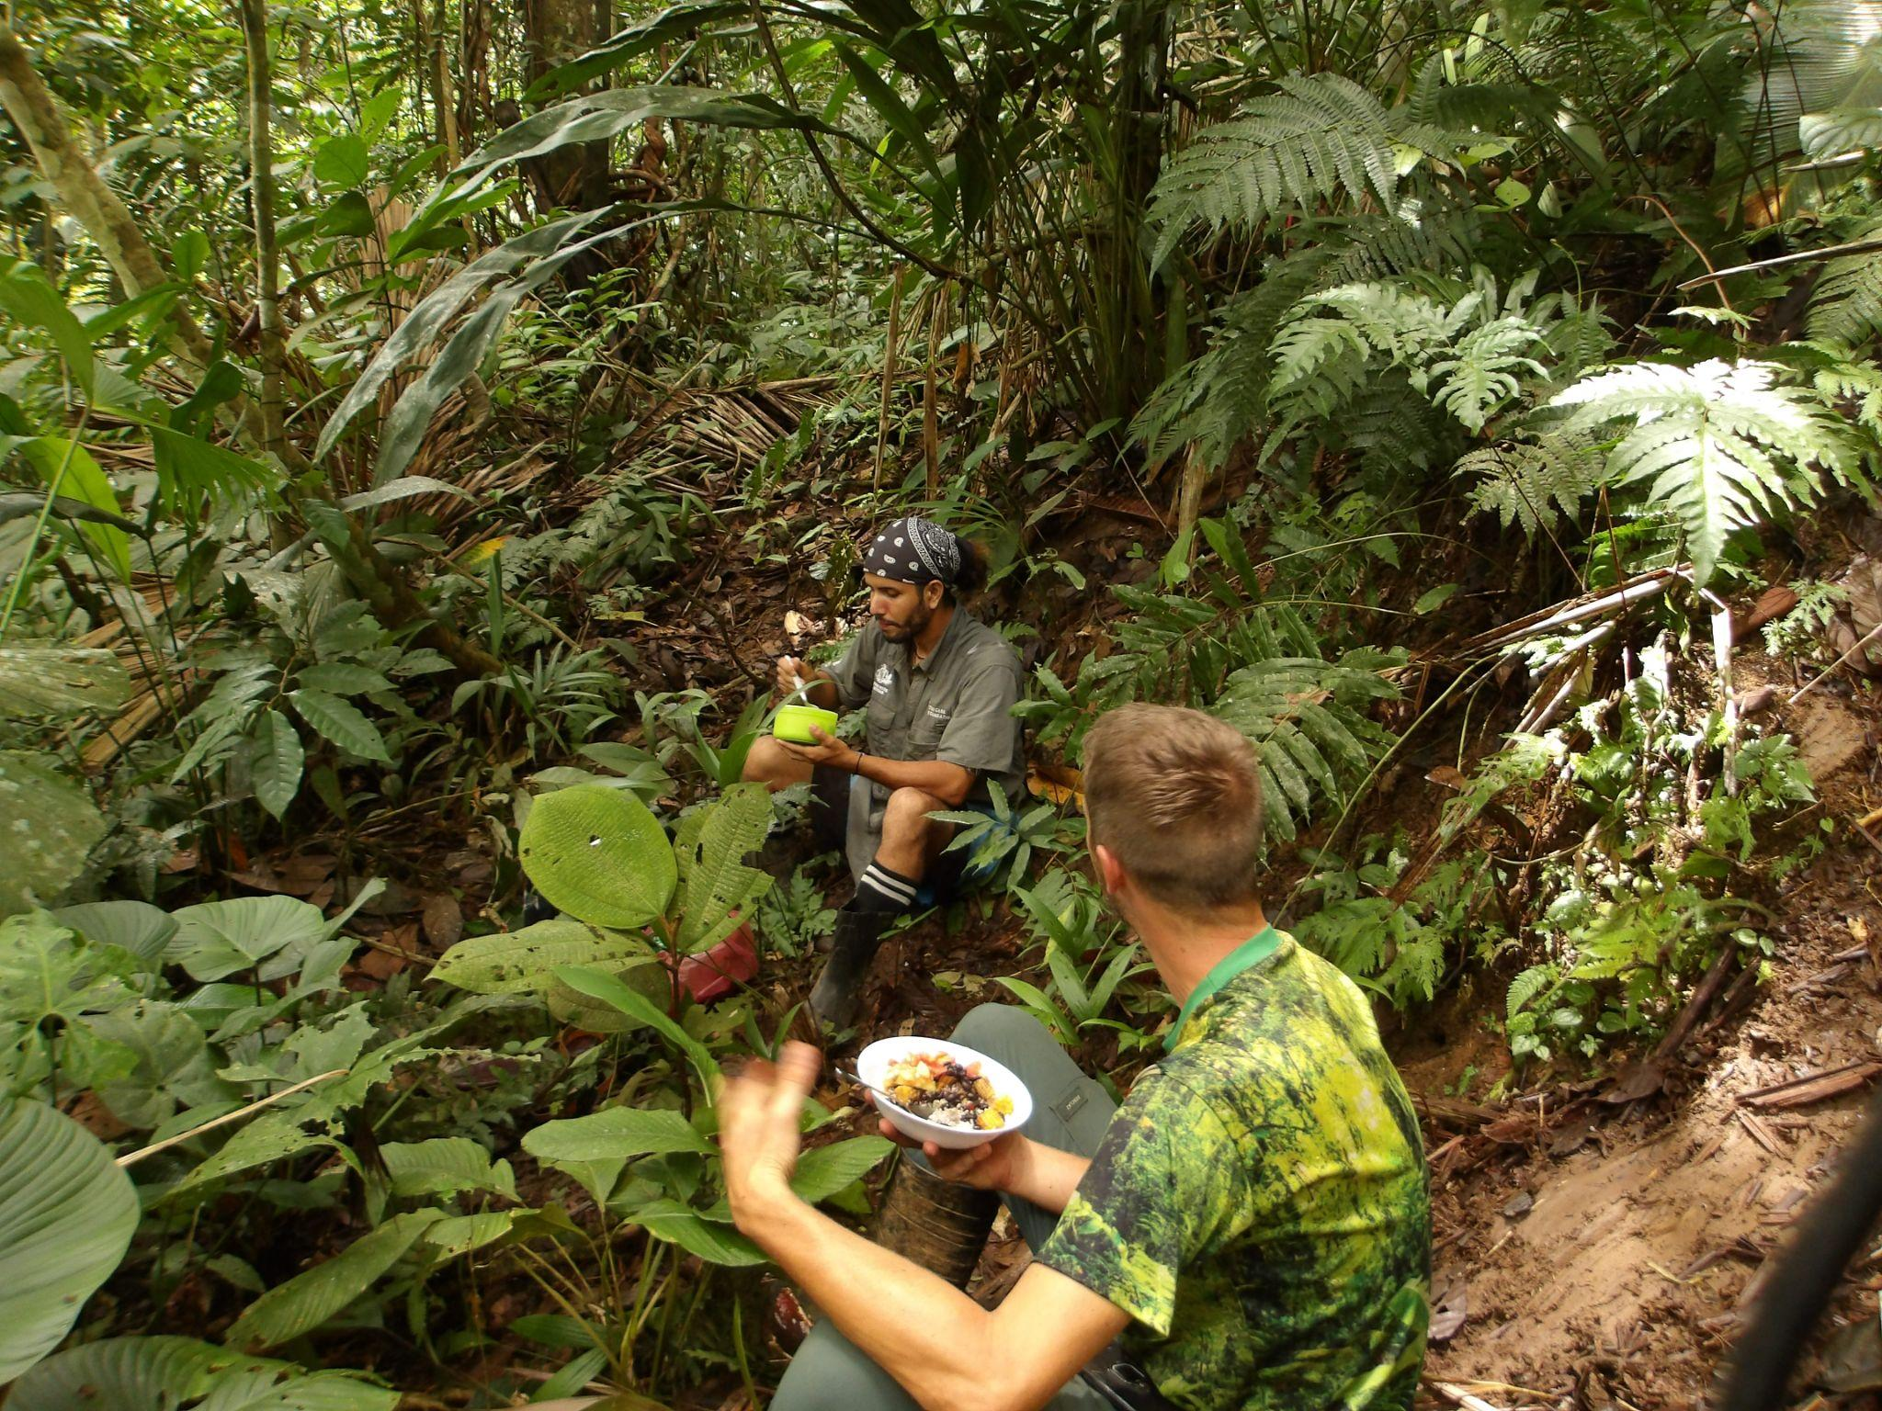
The Nature Reserve

Slide 9
Our Research Question
1. Which traits best define an LUH? How do these traits vary within LUHs?
2. Is OG1 an imposter??
Land Use Histories (LUHs)
Selective Logging
Old Growth
Vochasyia Plantation
Natural Regeneration

Slide 10
Forest traits that we looked into in each plot
Total Area
DBH (DBH CV, SD, MEAN)
Stems per ha (# of trees per Ha)
Basal area per ha
Pielou’s Evenness Index (Evenness of species in plot)
Two Species diversity indexes
  Shannon-Weiner diversity index (based on randomness present at a site and considers both species richness and equitability in distribution in a sample)
  Simpson diversity index (more a dominance index as it accounts proportion of species in a sample)
DBH (cm)
Total Area
1.3m POM
Total Area
Ha

Slide 11
Statistical Methods
Visualising traits across plots
Visualising these traits across LUHs
Testing to see which of these traits most strongly separate LUH using comparative statistical tests

Slide 12
Results

Slide 13
Variation within LUHs
We looked at the basic variation using the raw data from Y1 of the ELUBB project to get a sense of where the main variation occurs both within and across LUHs
Stem /ha
Basal area / ha
Mean DBH
Various species diversity indexes:
  Shannon diversity index
  Simpson’s diversity index
  Pielou’s evenness

Slide 14
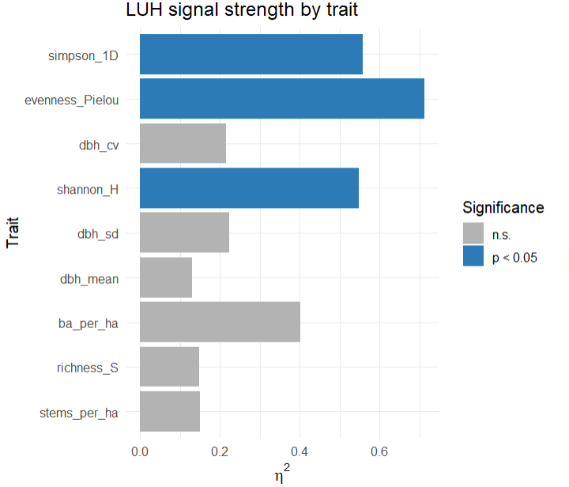
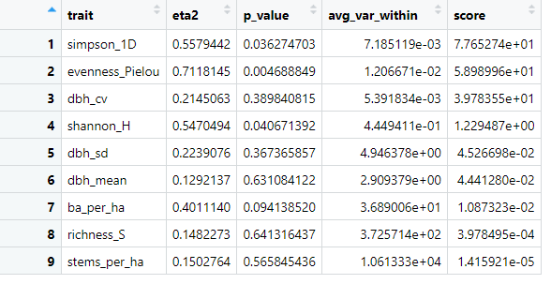
Ranking traits’ ability to differentiate between LUHs
Species diversity and evenness indices significantly varies between LUH, whereas the other variables do not
Notes:
Eta² (η²) — Effect size - The proportion of the total variation in a trait that’s explained by LUH type.
From where: Calculated from the one‑way ANOVA as:
\eta^2 = \frac{\text{SS}_{\text{between LUHs}}}{\text{SS}_{\text{total}}}
Interpretation:
0.00 → LUH explains none of the variation in the trait.
0.50 → half the variation in that trait is explained by LUH differences.
1.00 → LUH explains all the variation (perfect separation).
In plain language: Bigger η² means the LUH categories really matter for that trait.
p‑value — From the one‑way ANOVA F‑test
probability of seeing LUH group differences at least as large as what you observed if there were no real LUH effect (null hypothesis true).
From where: Comes from the ANOVA model trait ~ LUH.
Interpretation:
If p < 0.05 → the LUH means differ significantly (we reject the null hypothesis).
If p ≥ 0.05 → the differences could plausibly be due to random variation.
Avg var within — Average within‑LUH variance
For each LUH, calculated the variance of a trait among its plots, then took the average of those variances across LUHs.
Interpretation:
Low value → plots in the same LUH are similar for that trait (low within‑group noise).
High value → LUH members are very different from each other for that trait (high within‑group noise).
Why it matters: Even if η² is high, a high within‑group variance can mean the trait is less reliable for classification — your “score” (η² ÷ avg var within) accounts for this.
How they work together
η² tells you the strength of LUH separation (signal).
p‑value tells you whether that signal is statistically reliable.
Avg var within tells you how consistent the trait is within each LUH (noise).

Slide 15
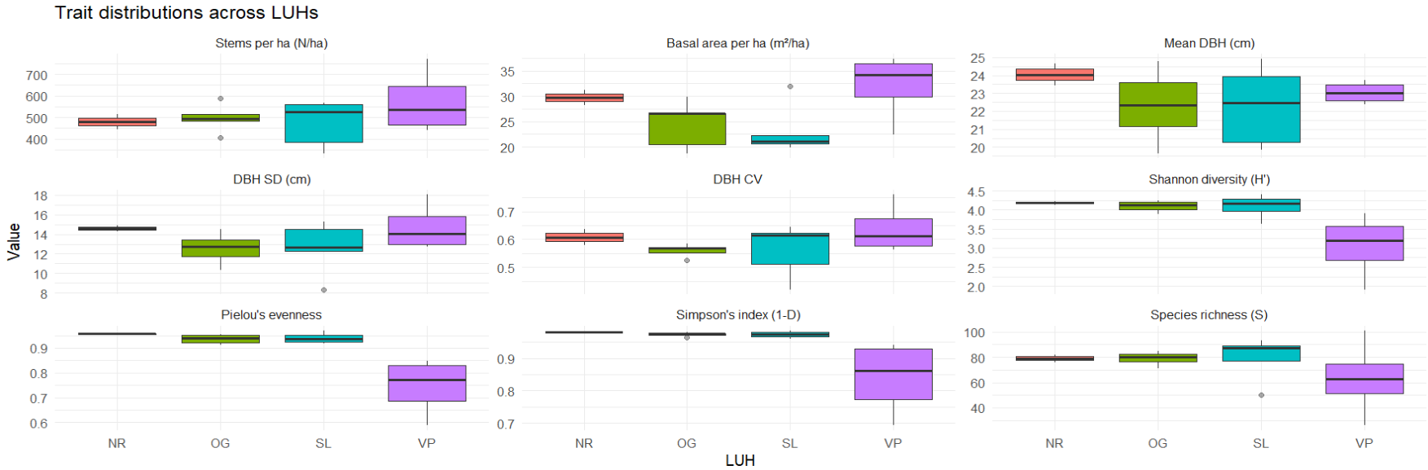
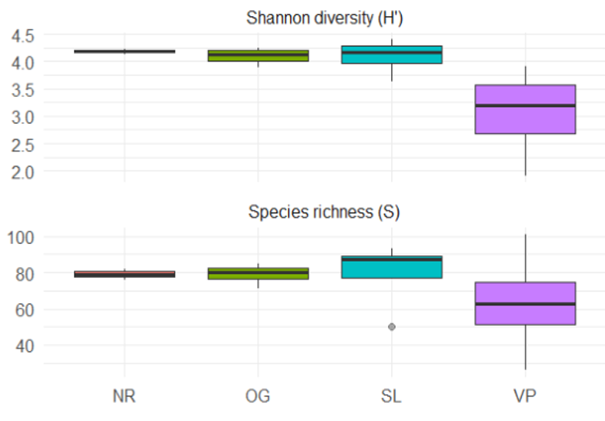
Traits that most strongly determine LUH type
Red = Significantly different between LUHs.

Slide 16
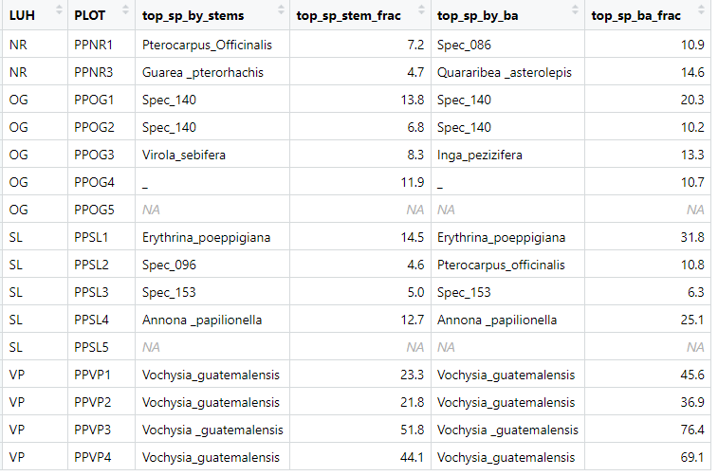
Dominant species in each LUH

Slide 17
Putting our findings into practice: should OG1 be OG or is it really NR?

Slide 18
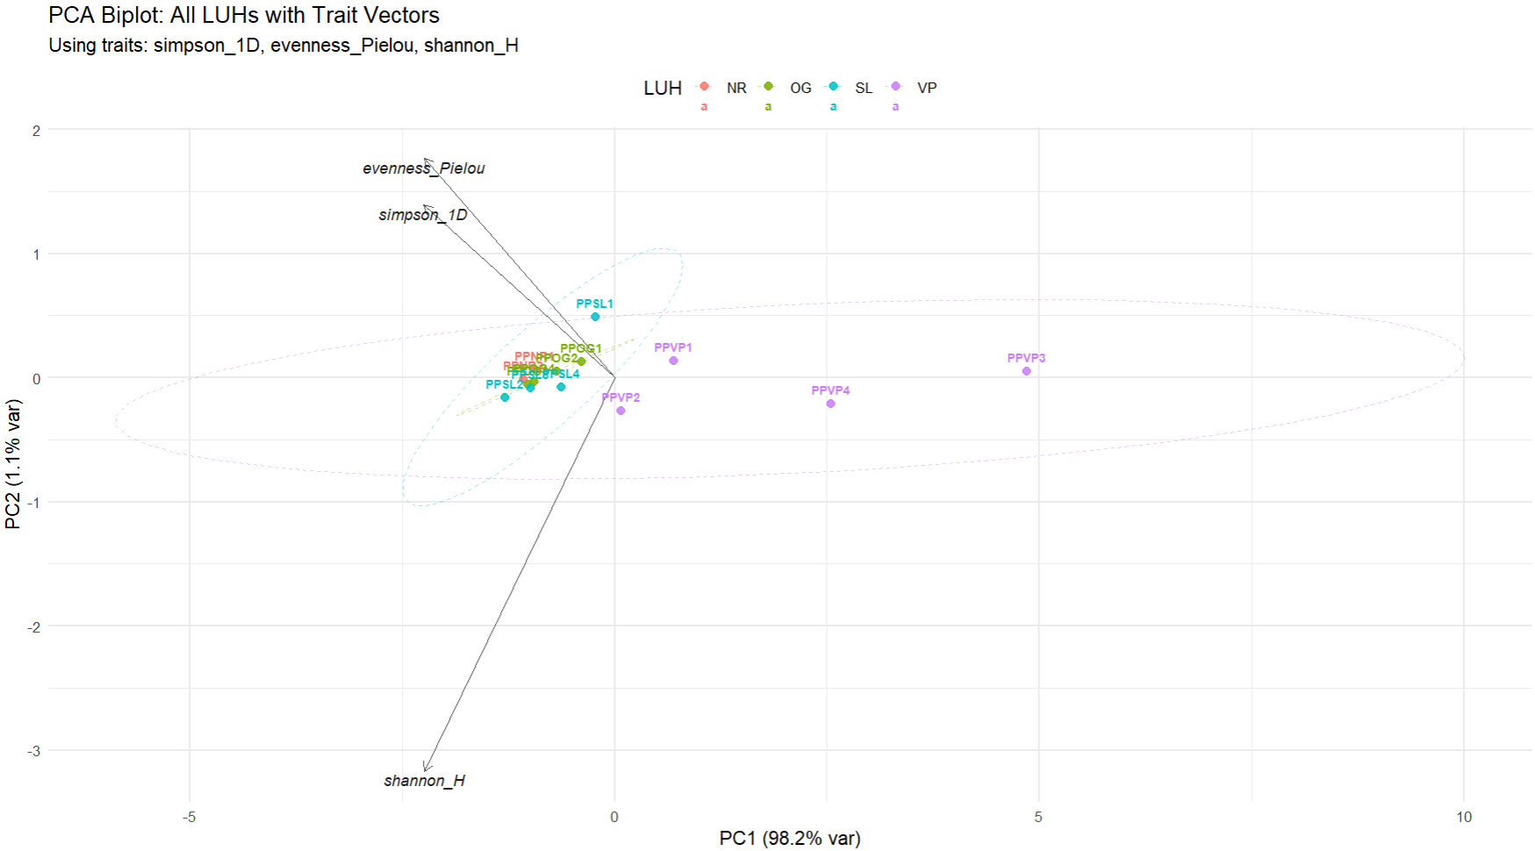

Slide 19
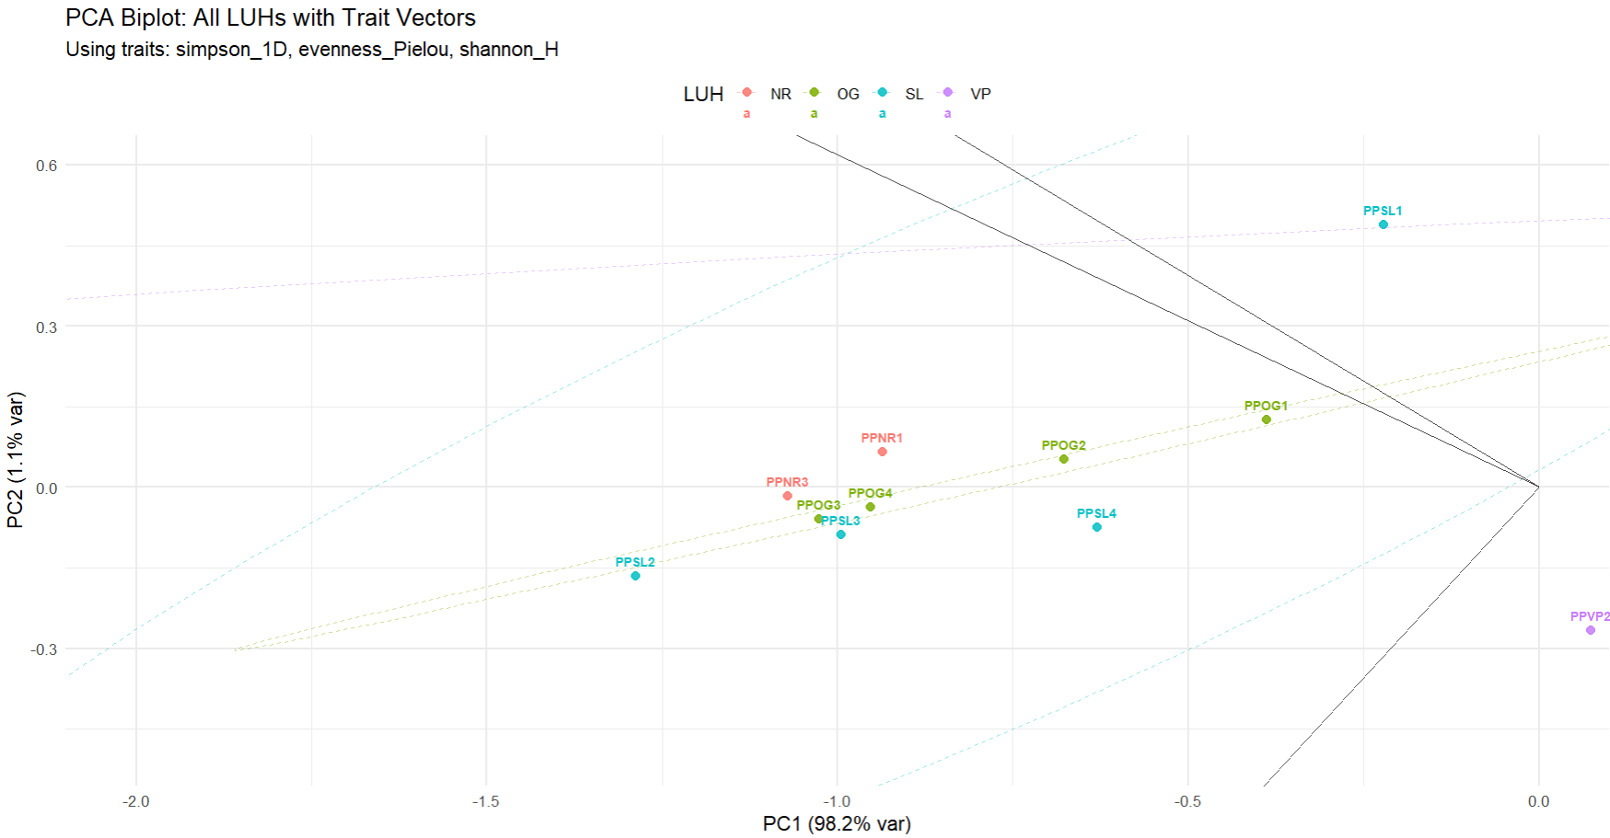

Slide 20
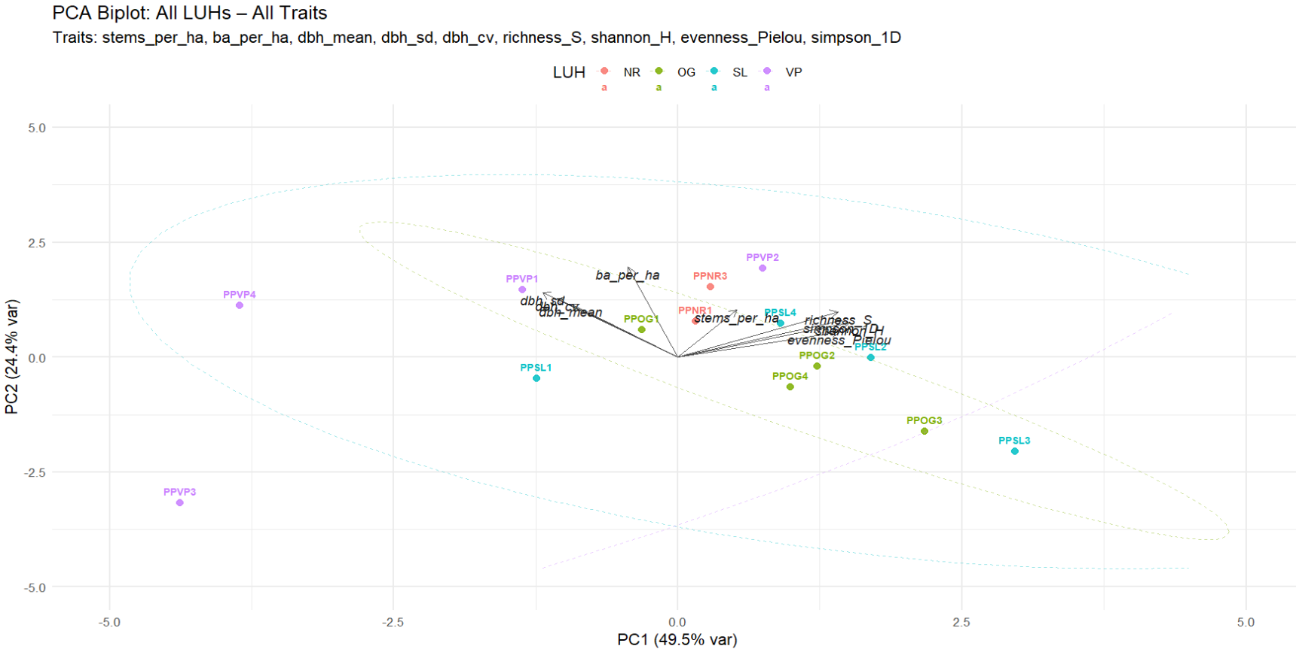
Notes:
The apparent drop in PC1’s % variance is just a result of including more traits with different information, which spreads variance over more components. The PCA is still just as valid — it’s now giving a richer, more balanced view of trait space.

Slide 21
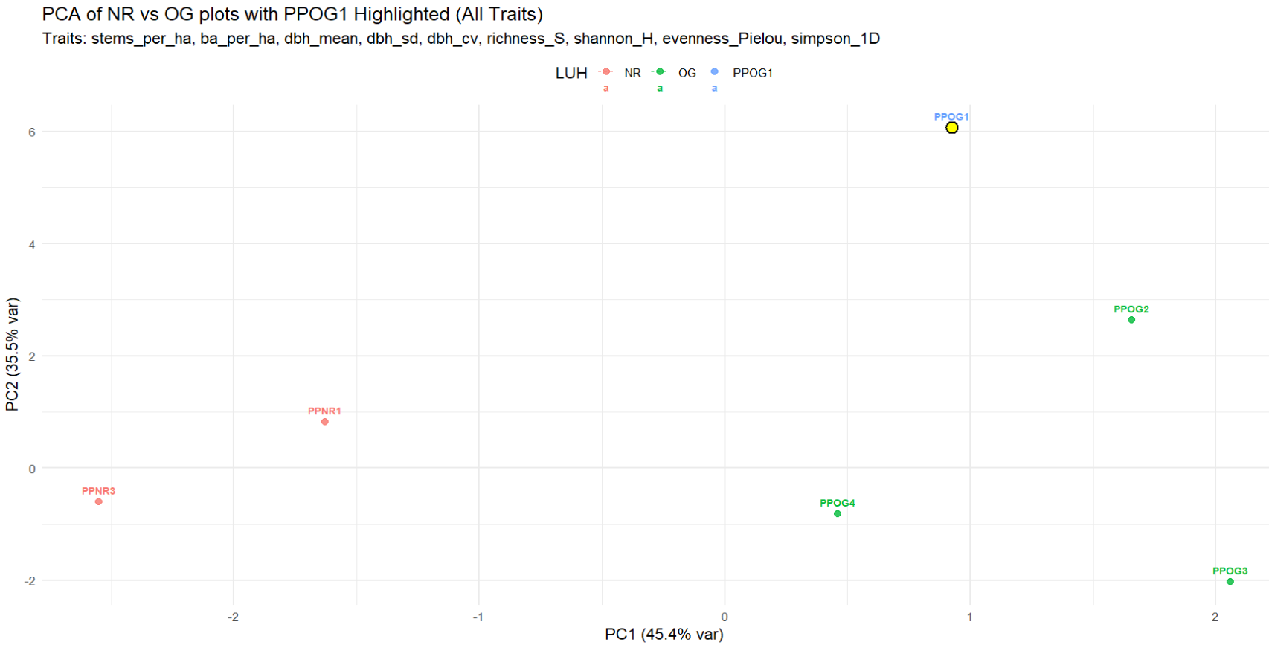
Should OG1 be NR or OG?
Notes:
No strong statistical support for either LUH identity in the distance‑based permutation test. LDA gives a modest lean towards NR, but not strong enough to override the lack of significance.
In ecological terms: PPOG1 sits between the NR and OG “clouds” in trait space, with only a subtle pull towards NR.

Slide 22
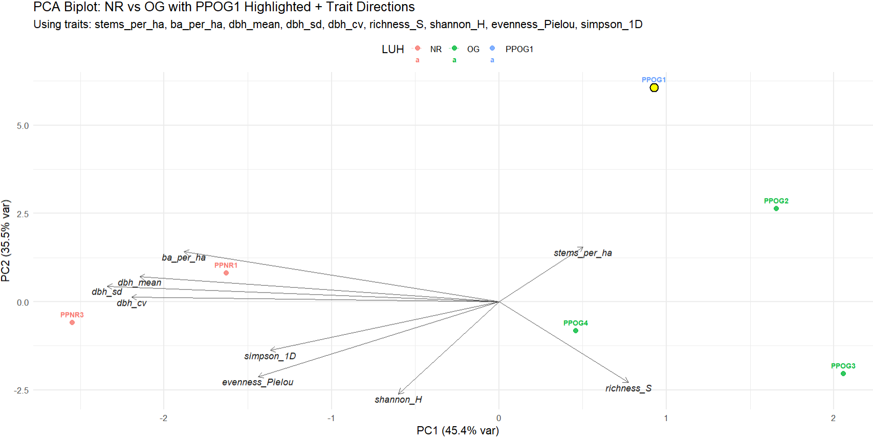
Should OG1 be NR or OG?
Notes:
All three statistical checks agree: PPOG1 clusters with OG, not NR, in the tested trait space — no support for re‑labelling as NR.
Distances: PPOG1 is numerically closer to OG than NR (Δ positive). Permutation test: Large p‑values → no evidence that PPOG1 is unusually close to NR.
LDA posterior: 100 % OG, 0 % NR → the traits classify it firmly as OG.

Slide 23
Summary
Species diversity and Evenness Seem to be the best discriminators! Significantly differing between LUHs.
The evidence seems to go towards keeping OG1 as Old Growth HOWEVER this evidence is poorly significant
WE NEED MORE PLOTS DATA and TIME!
We recommend going off actual Land Use history traits such as the VP plots. Statistical tests may not be enough at this stage to segregate them as we know little as to how specific LUH may reshape forest communities….

Slide 24
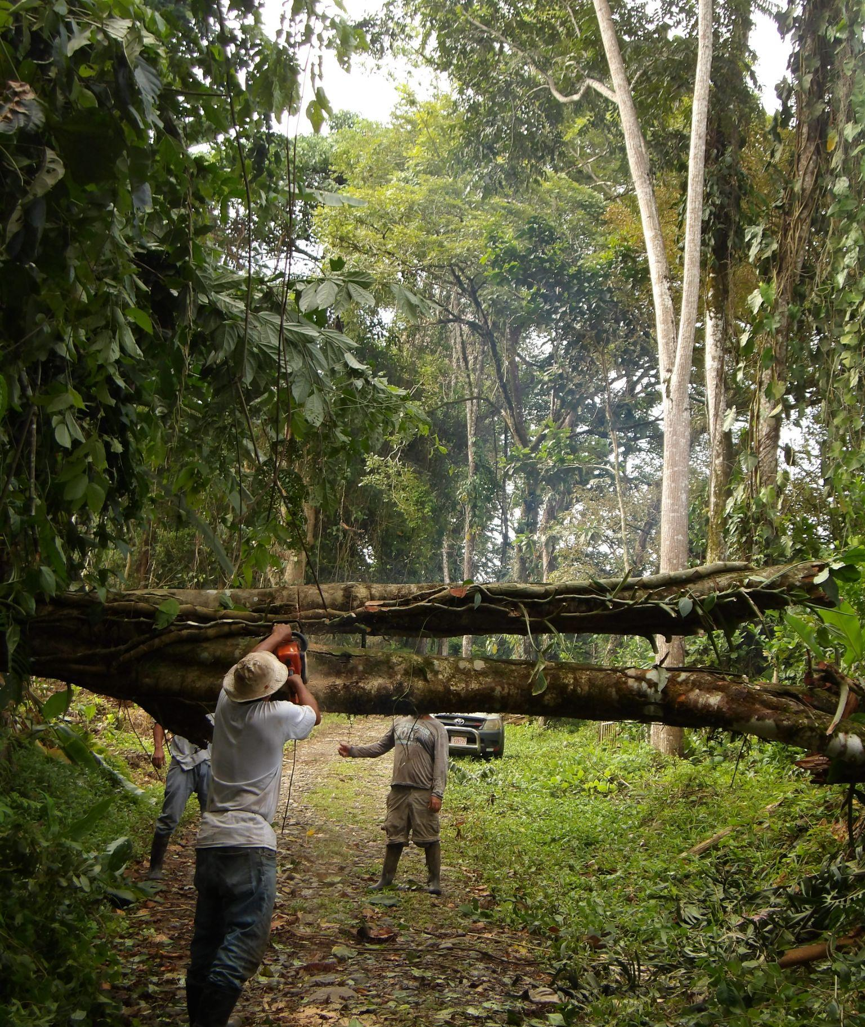
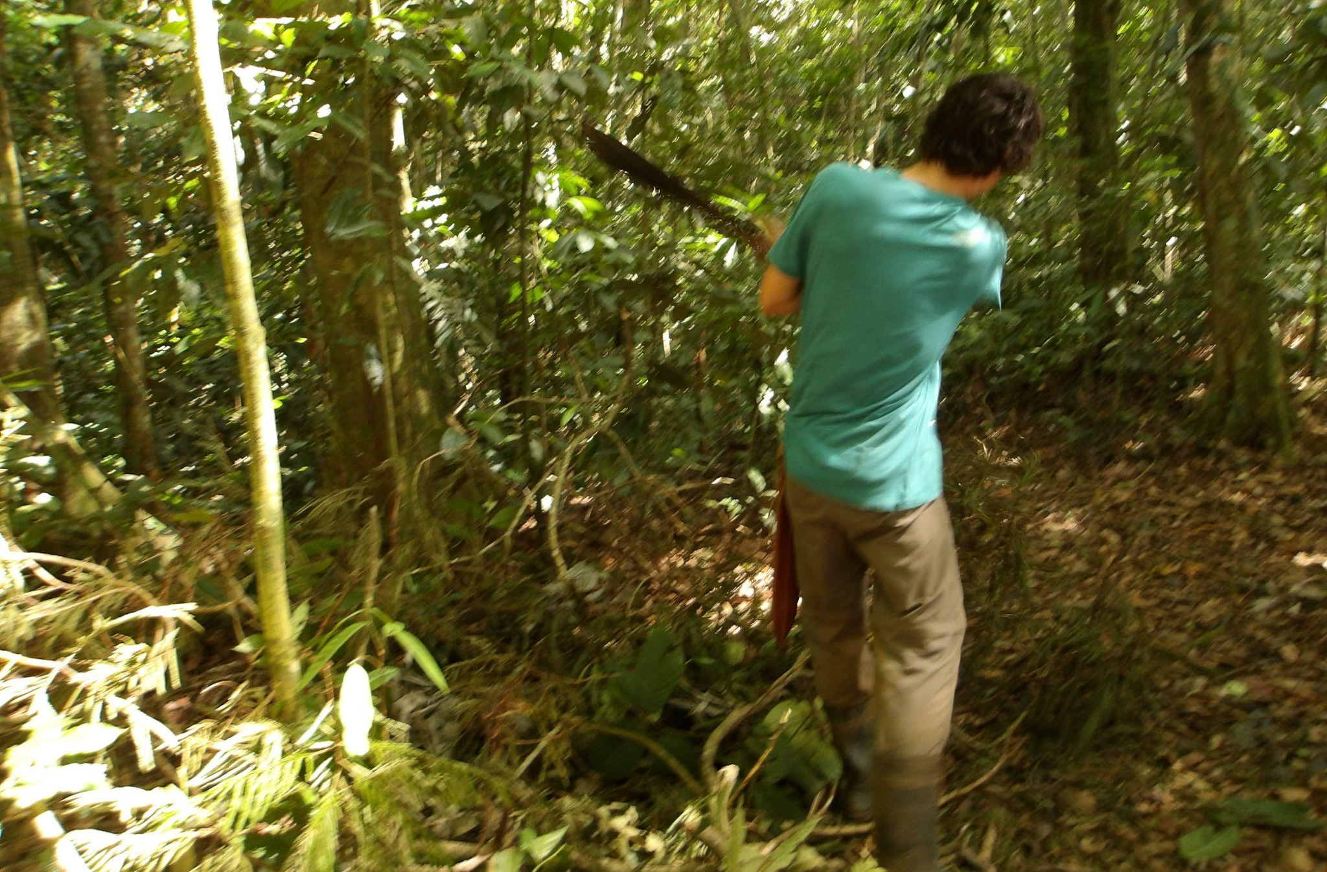
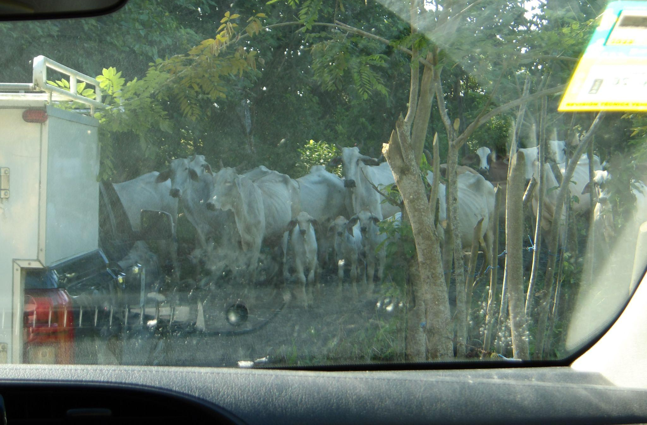
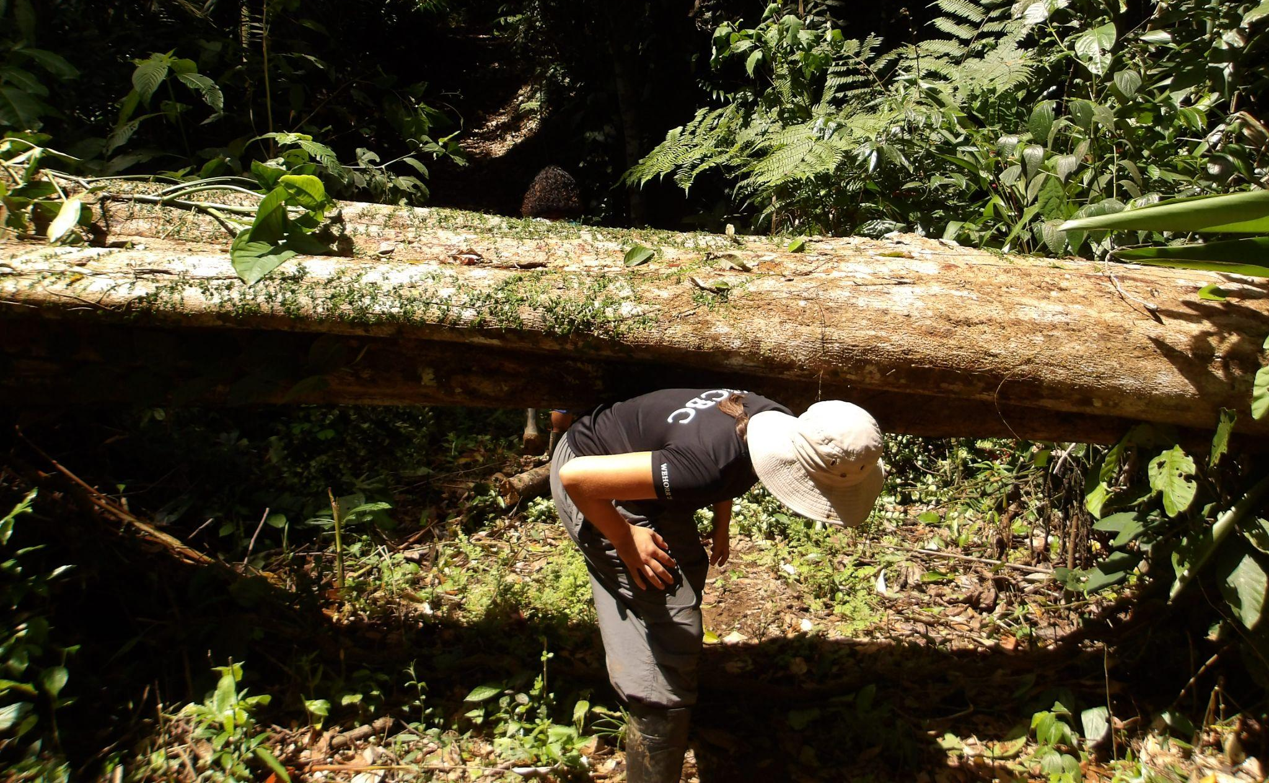
Some bumps along the way!

Slide 25
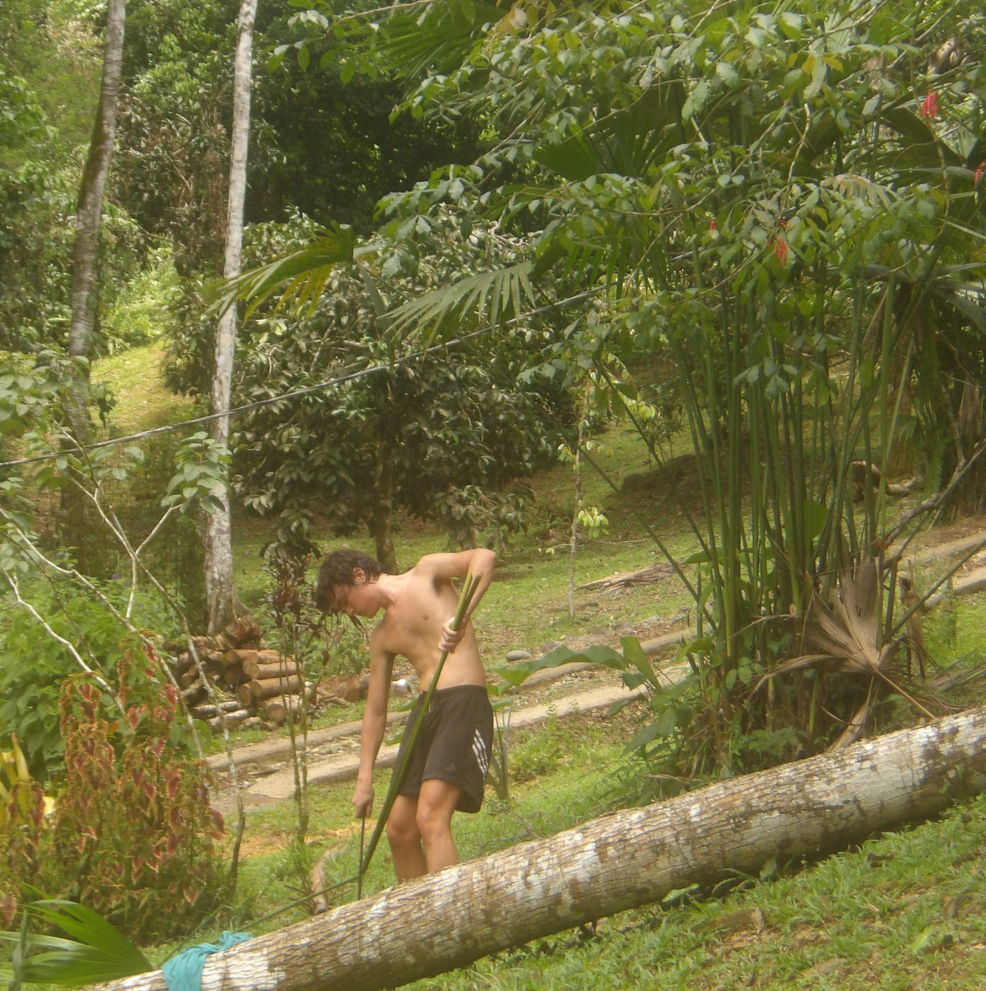
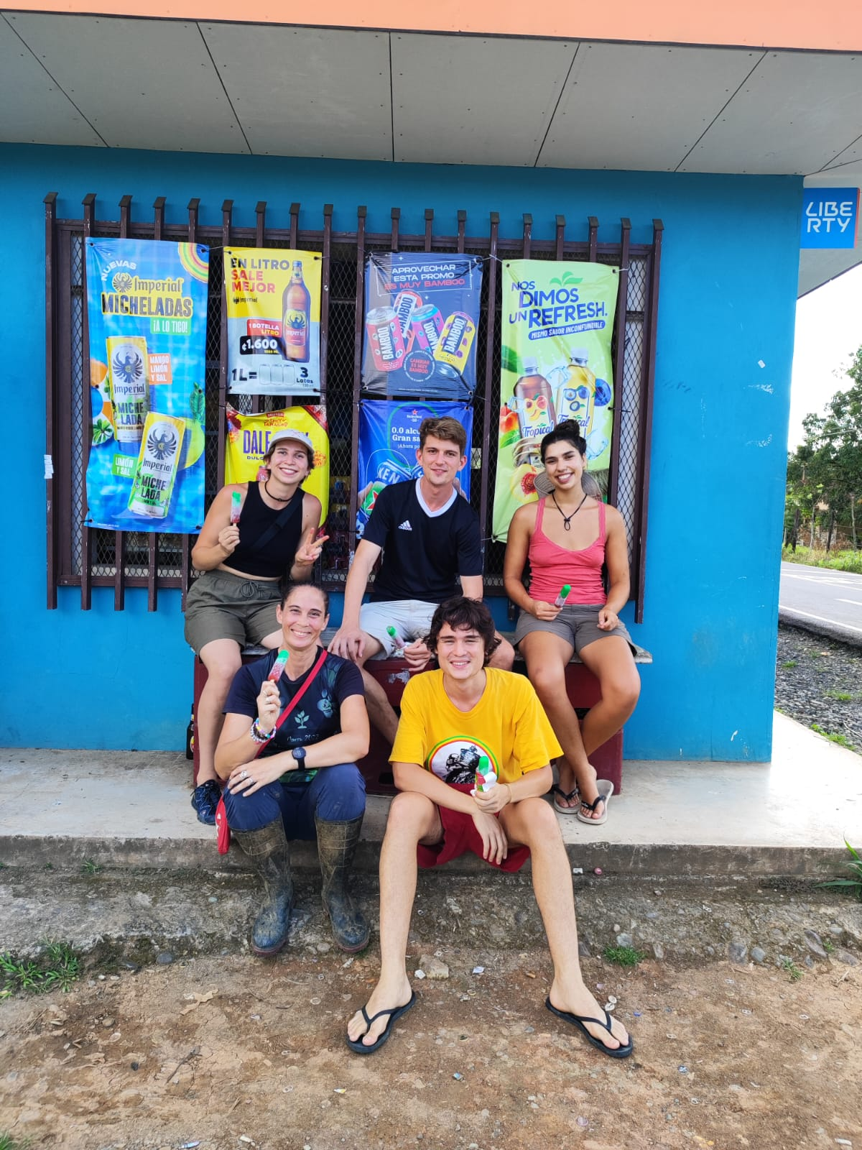
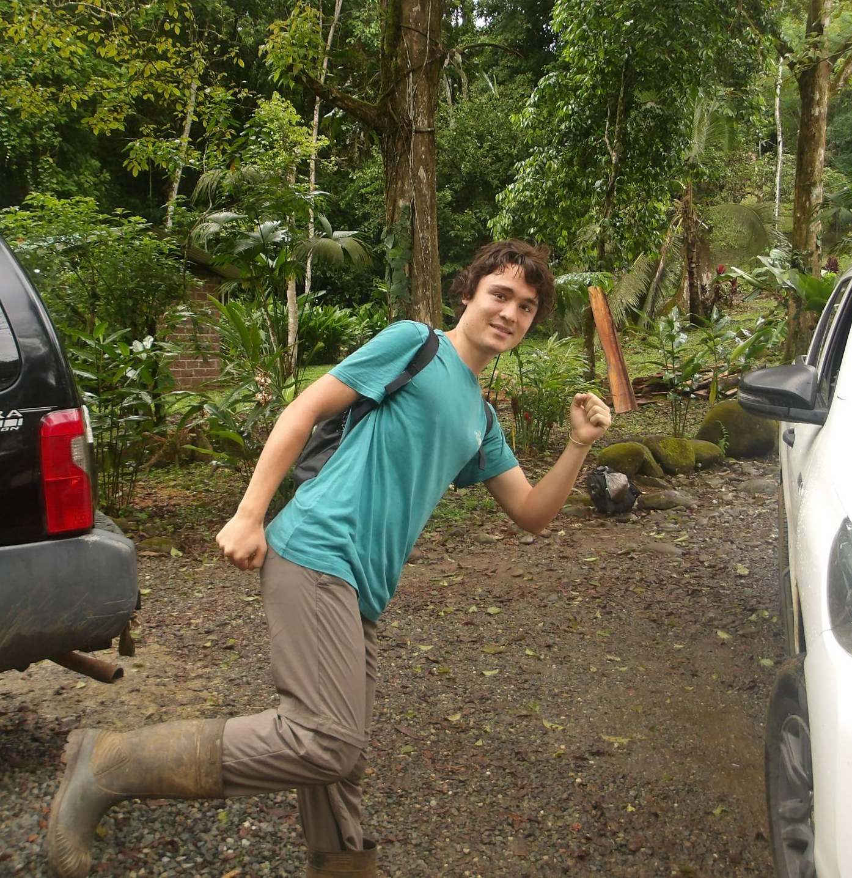
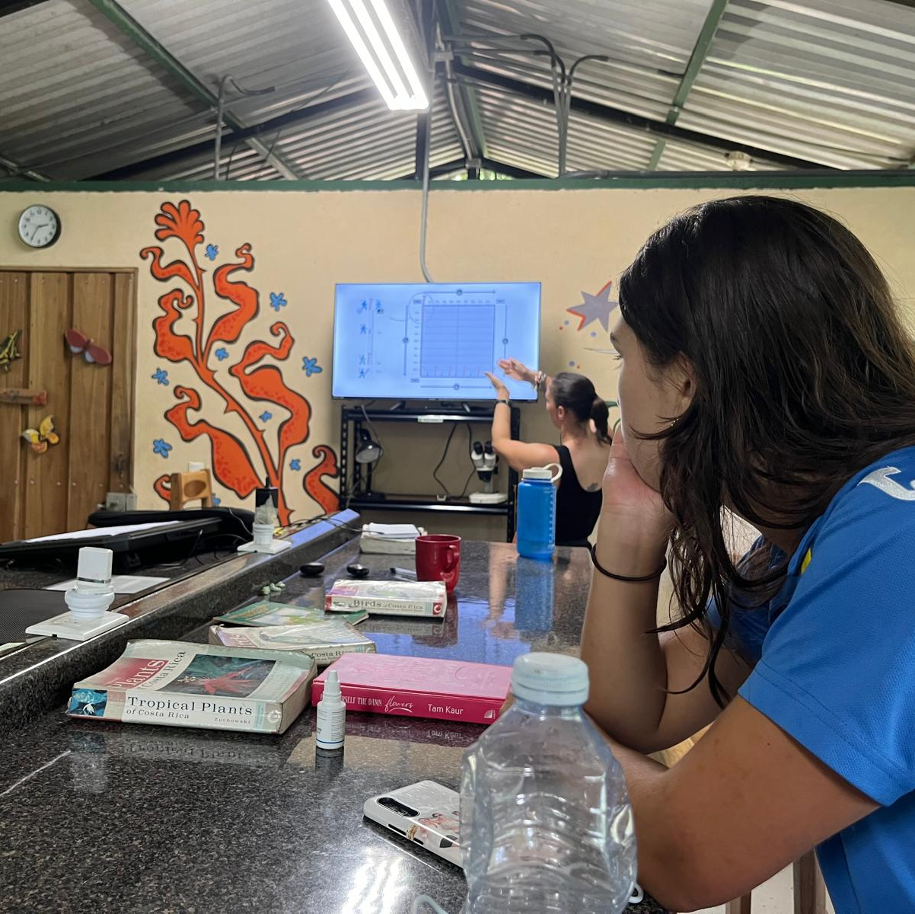
Weeks at WWN
Garden Day!
ELUBB
Sustainability day!
Spanish Lessons
ELUBB

Slide 26
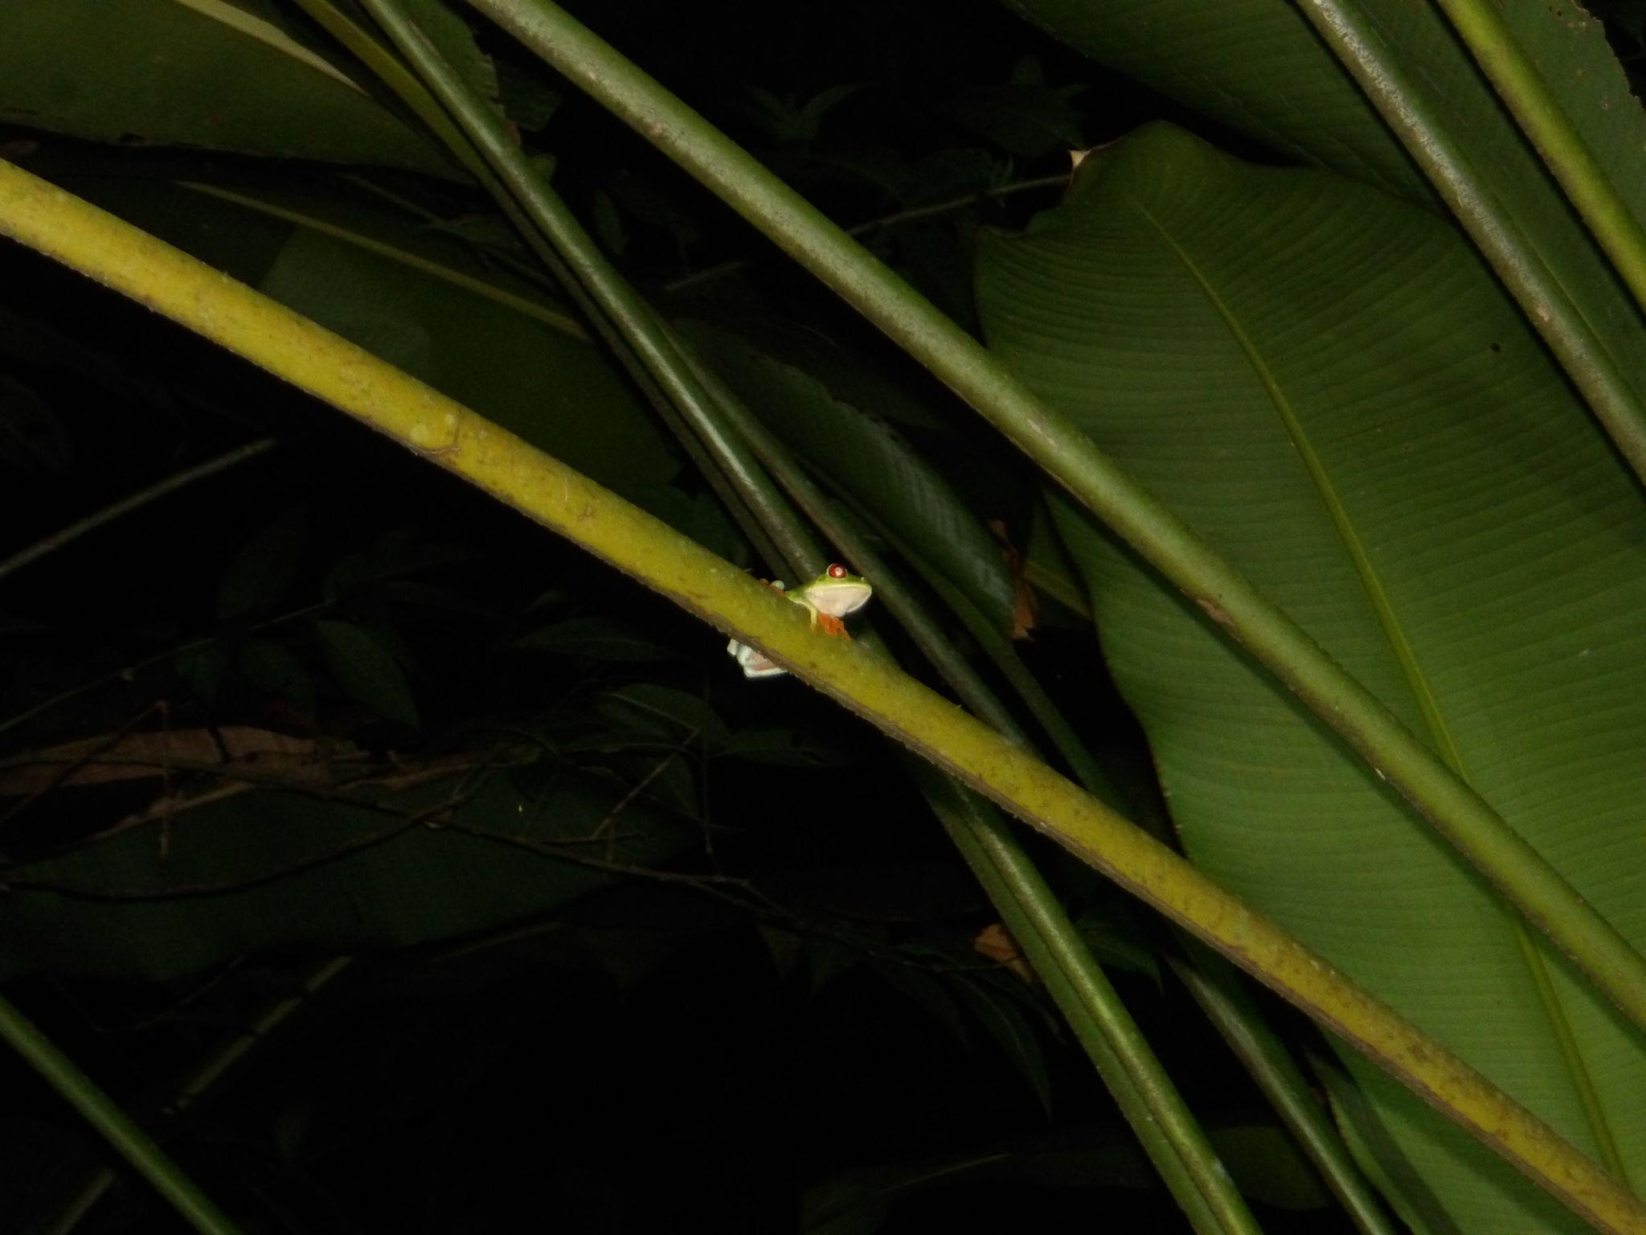
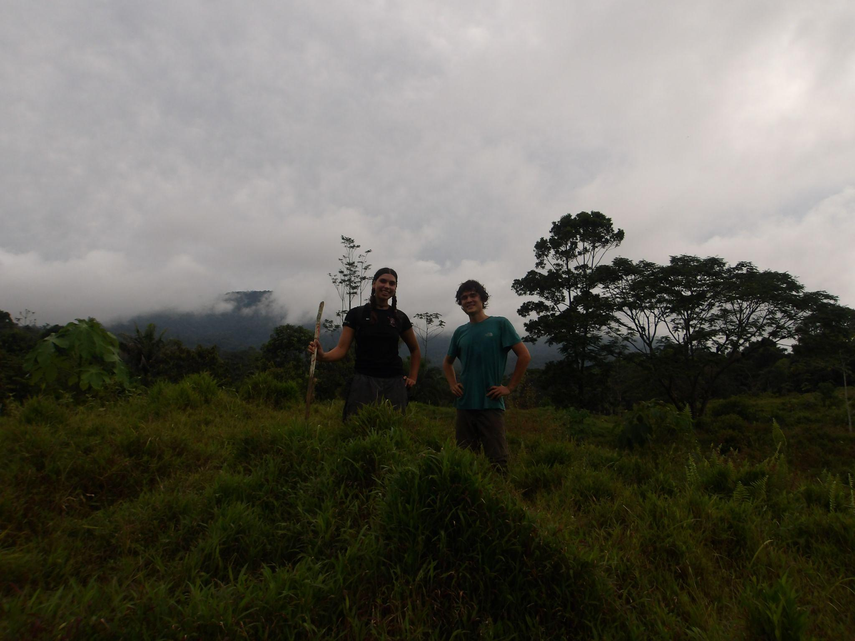
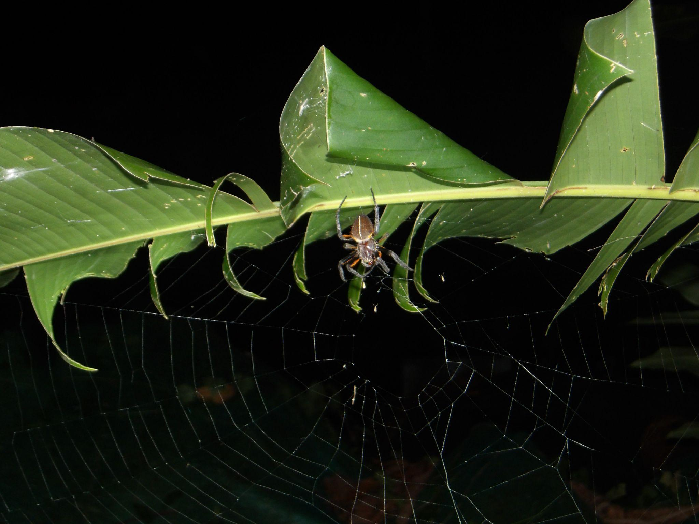
Thank you!
We have had an amazing a time at WWN CR, it will be an experience we will never forget and we hope to keep students coming from our University long after us to support your incredible work here.

